Slide 1
New and Noteworthy:
Medications Coming to Market
Sarah Embrey, PharmD, BCPS
Clinical Pharmacy Specialist
Enterprise Medication Use Team
WVU Medicine
Sarah.Embrey@wvumedicine.org

Slide 2
Objectives
Identify new medications currently available or coming to market soon
Discuss how new medications may impact patient care and treatment guidelines
Review the biosimilar drug approval process and the effect on prescribers

Slide 3
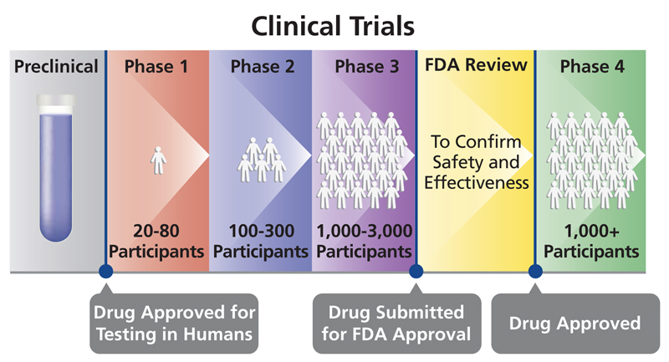
Drug Approval Process
PDUFA
https://oncobites.blog/2019/12/17/how-does-a-drug-get-approved/
Notes:
Phase I – safety, done in healthy patients (except oncology)
Phase II – efficacy is primary focus, but safety is secondary. Tested in “sick” patients
Phase III – “real world” population, look for adverse effects missed in smaller sample sizes of previous groups. Also still looking at safety and efficacy
Phase IV – post-marketing studies

Slide 4
What’s a PDUFA?
PDUFA = Prescription Drug User Fee Act
Once FDA accepts a filing for drug approval, review must be completed within 10 months
  “Deadline” for review is the PDUFA date
Priority Review = PDUFA date within 6 months
Dates not written in stone – FDA can request additional information and extend the date

Slide 5
Approved and Available

Slide 6
Not quite available yet

Slide 7
Trends among pipeline medications

Slide 8
COVID19 Therapeutics and Vaccines

Slide 9
Monoclonal Antibodies

Slide 10
Orphan Drugs

Slide 11
Additional Indications for
Established Oncology Agents

Slide 12
CAR-T Medications and
Cellular Immunotherapy

Slide 13
HIV Antiretrovirals

Slide 14
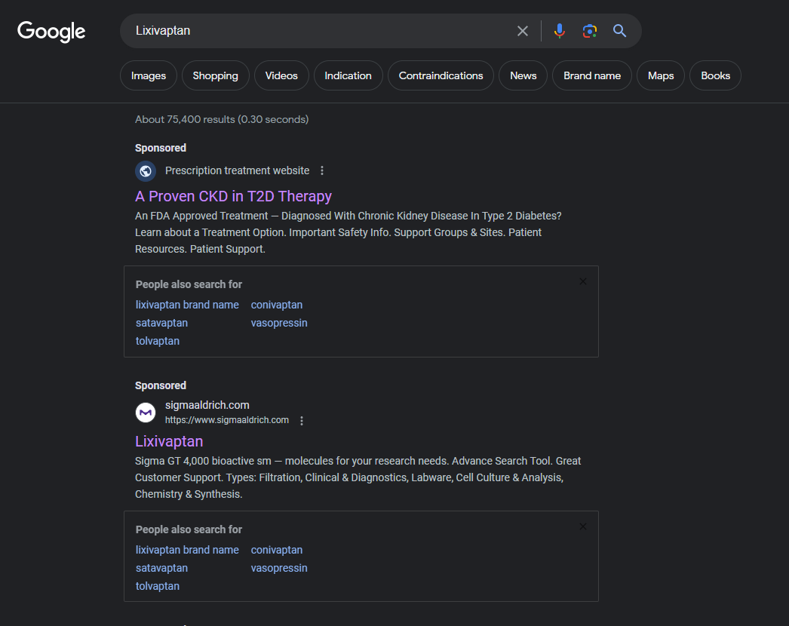
Consumer Caution
Advertisement for finerenone (not the drug searched for)
Lixivaptan is seeking indication for autosomal dominant polycystic kidney disease.

Slide 15
Biosimilars: a growing area

Slide 16
All in a Name…
Biologic
Medication that comes from organism
Can’t be made from “chemical recipe”
Biosimilar
Very similar to the original biologic it is modeled after
No clinically meaningful differences from the original biologic
Interchangable Biosimilar
Biosimilar product that can be substituted without the intervention of the prescriber
“Pharmacy-level substitution”
Medication
Created from chemicals
Able to create more based on “recipe”
Can create generics that are exact copies of branded medication
Not able to be 100% the same (no generic biologics)

Slide 17
Insulin Example
Insulin glargine
Lantus (Sanofi)
Insulin glargine-yfgn
Semglee (Mylan)
July 2021
Interchangable biosimilar
Insulin glargine-aglr
Rezvoglar (Eli Lilly)
December 2021
Interchangable biosimilar
Notes:
Rezvoglar (insulin glargine-aglr) was approved in December 2021 as the second insulin glargine biosimilar. This long-acting basal insulin is indicated for adults and children with T1D as well as for adults with T2D.²¹ Unlike Semglee, Rezvoglar requires the prescriber’s approval before dispensing; this is because insulin glargine-yfgn is an interchangeable biosimilar and insulin glargine-aglr is not.⁴ The readily available formulation is a 3-mL prefilled KwikPen (100 mg/mL), with once-daily subcutaneous administration.²¹ This product, like insulin glargine-yfgn, should not be diluted or mixed with other types of insulin or solutions.²¹
Because it is a biosimilar, insulin glargine-aglr has a mechanism of action that is very similar to that of insulin glargine. As previously noted, insulin’s primary function is to regulate glucose metabolism. The stimulation of peripheral glucose uptake and inhibition of hepatic glucose production reduce the BG concentration. The use of insulin glargine-aglr to treat diabetic ketoacidosis is not advised.²¹

Slide 18
Biosimilar Overview
OK to substitute without authorization from provider!
Patented Drug Approval
Biosimilar Approval
Biosimilar Approved to be Interchangable
Notes:
The FDA previously approved Rezvoglar as a biosimilar in December 2021 based on data demonstrating that there were no clinically meaningful differences between the biosimilar and the reference product. As an interchangeable biosimilar, Rezvoglar may now be substituted for Lantus at the pharmacy level without the need for an intervention from the prescriber.

Slide 19
Summary
Many new medications currently in the development pipeline
Cost will continue to be a factor for patients when prescribing new medications
Biosimilars can improve access to costly medications, but the writing and authorization process can be tricky

Slide 20
New and Noteworthy:
Medications Coming to Market
Sarah Embrey, PharmD, BCPS
Clinical Pharmacy Specialist
Enterprise Medication Use Team
WVU Medicine
Sarah.Embrey@wvumedicine.org

Slide 21
Ansofaxine Hydrochloride (LY03005)
Stage:
Route: oral
Indication: major depressive disorder
Class: norepinephrine-dopamine reuptake inhibitor; serotonin-norepinephrine reuptake inhibitor (SNRI)

Slide 22
Pivmecillinam Hydrochloride (Pivya)
Stage:
Route: oral
Indication: complicated or uncomplicated urinary tract infection
Class: penicillin antibiotic

Slide 23
Sofpironium Bromide (Sofdra)
Stage:
Route: topical
Indication: axillary hyperhidrosis
Class: anticholinergic agent

Slide 24
Vonoprazan (Voquezna)
Stage:
Route: oral
Indication: gastroesophageal reflux disease (GERD)
Class: potassium-competitive acid blocker (P-CAB)

Slide 25
Insulin Icodec (LAI287)
Stage:
Route: subcutaneous
Indication: type 1 or type 2 diabetes
Class: insulin analog

Slide 26
Glatiramer Acetate (GA Depot)
Stage:
Route: intramuscular
Indication: relapsing multiple sclerosis or primary progressive multiple sclerosis
Class: immunomodulator

Slide 27
Amikacin Sulfate (Arikayce Kit)
Stage:
Route: inhaled
Indication: cystic fibrosis patients with Pseudomonas aeruginosa
Class: aminoglycoside antibiotic

Slide 28
Naloxone Hydrochloride
(Naloxone Lotion)
Stage:
Route: topical
Indication: opioid reversal agent
Class: antidote

