Slide 1



Pain Management and Opioid Safety
Mike Brown, Pharm.D., Ph.D., BCPS

Slide 2
Disclaimer
I have no financial conflicts of interest to disclose.
The views presented here are based on my clinical experience and on the pain science research I read. They do not represent an official position of the US Department of Veterans Affairs or the Hershel “Woody” Williams VA Medical Center with the exception of any VHA guidelines which may be discussed.

Slide 3
objectives
Identify appropriate candidates for opioid pharmacotherapy.
Develop treatment plans for initiation or continuation of opioid pharmacotherapy including selection of the appropriate opioid medication.
Identify appropriate risk mitigation strategies.
Assess the appropriate level of risk mitigation required based on patient specific factors.
Understand WV specific laws related to opioid prescribing.
Creating and monitoring a successful opioid tapering strategy.

Slide 4
Target Concepts of Pain
Pain is normal, personal, and always real
There are danger sensors, not pain sensors
Pain and tissue damage rarely relate
Pain depends on the balance of danger and safety
Pain involves distributed brain activity
Pain relies on context
Pain is one of many protective outputs
We are bioplastic
Learning about pain can help the individual and society
Active treatment strategies promote recovery
Butler, D. and Moseley, G 2017. Explain pain supercharged. Adelaid City West

Slide 5
Pain Terminology
Pain – An unpleasant sensory AND emotional experience associated with actual or potential tissue damage, or described in terms of such damage.
Acute Pain – Pain caused by noxious stimuli that improves when the underlying injury heals
Chronic Pain – Maladaptive pain frequently related to physiological changes distant from the site of injury which is typically greater than 90 days in duration
Allodynia – Pain due to stimulus that does not typically cause pain (ie, putting a shirt on)
Hyperalgesia – Increased response to a stimulus that is normally painful
Bonica’s Management of Pain 5th Ed – 2019 Wolters Kluwer

Slide 6
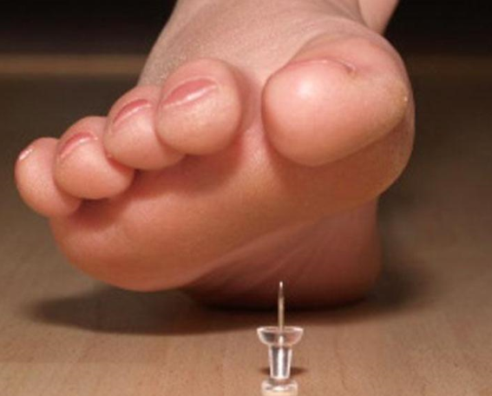
Types of Pain
Somatic or Nociceptive Pain -> Stubbed toe
  Aching, throbbing, sharp, with good focus of pain
Visceral Nociceptive Pain -> Organs
  Diffuse, squeezing/pressure, gnawing, poorly localized
Neuropathic Pain
  Burning, numb, radiating, shooting, stabbing, pin cushion
Bonica’s Management of Pain 5th Ed – 2019 Wolters Kluwer

Slide 7
Pain Evaluation
Functional Pain Scale (PEG)
0-10 Scale from low to high
Questions to Ask
Onset
Location
Duration
Character
Aggravating Factors
Remitting Factors
Timing
Severity
What number best describes your average pain in the past week?
What numbers best describes how, during the past week, pain has interfered with your enjoyment in life?
What number best describes how, during the past week, pain has interfered with your general activity?

Slide 8
Red flag symptoms – Particularly Lower Back Pain
Possible Condition | Red Flag Symptoms
Cauda equina/Conus medullaris | Urinary Retention; Urinary or fecal incontinence; Saddle anesthesia; Changes in rectal tone; Severe/progressive lower extremity neurological deficits
Infection | Fever; Immunosuppression; IV drug use; Recent infection, indwelling catheter or lines
Fracture | History of osteoporosis; Chronic corticosteroid use; Old age (> 75 yrs); Recent trauma; Younger patients at risk for overuse fracture
Cancer | History of cancer with new onset back pain; Unexplained weight loss; Failure of LBP to improve after one month; Age > 50 years; Multiple risk factors present
2022 VA/DoD Lower Back Pain Guidelines

Slide 9
When to image – American College of Radiology
Pain Location | Imaging May be Indicated | Imaging Not Indicated
Lower Back Pain | Suspect cauda equina syndrome; Chronic steroid use; Interventional candidate after 6 weeks of medical management; Elderly patients; History of prior lumbar surgery; Trauma; Osteoporosis; Immunosuppression; Suspected infection; Suspected spinal mets | Acute, no red flags, no prior pain management; Chronic, no red flags, no prior management
Chronic Hip Pain | Imaging almost always appropriate
Chronic Knee Pain | Imaging almost always appropriate
Chronic Shoulder Pain | Imaging almost always appropriate
Headache | Often appropriate in cases of escalating severity and/or patient risk factors
2022 ACR Appropriateness Criteria
Notes:
I know, I’m a pharmacist…what do I know about imaging? My supposition is we focus too much on imaging in inappropriate situations and get patients obsessed with it…unless they are acutely losing function, how does imaging change our treatment plan?

Slide 10
Opioid Mechanism
Mu | Kappa | Delta
Spinal and supraspinal analgesia Respiratory depression CV effects Physical dependence Tolerance Decreased GI motility Urinary retention Pruritus Euphoria | Spinal and supraspinal analgesia Miosis Psychotomimetic effects (dysphoria and agitation) Sedation Dysphoria | Spinal and supraspinal analgesia Anxiolytic
Trescot et al, 2008
Valentino et al, 2018

Slide 11
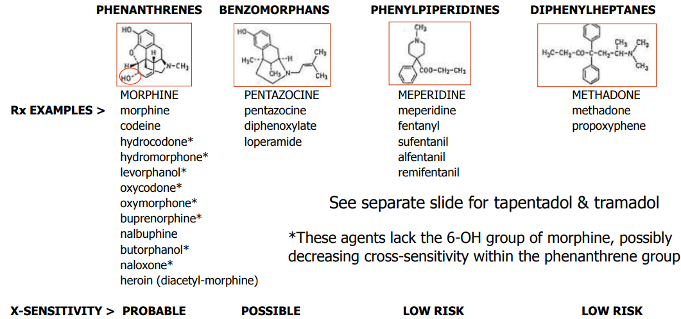
Chemical Classification of Opioids
Trescot et al, 2008.
Pain Pharmacy Bootcamp
Notes:
Opiate is a natural opioid derived from the poppy seed (morphine, heroin, codeine
Opioid is anything else

Slide 12
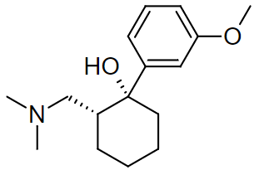
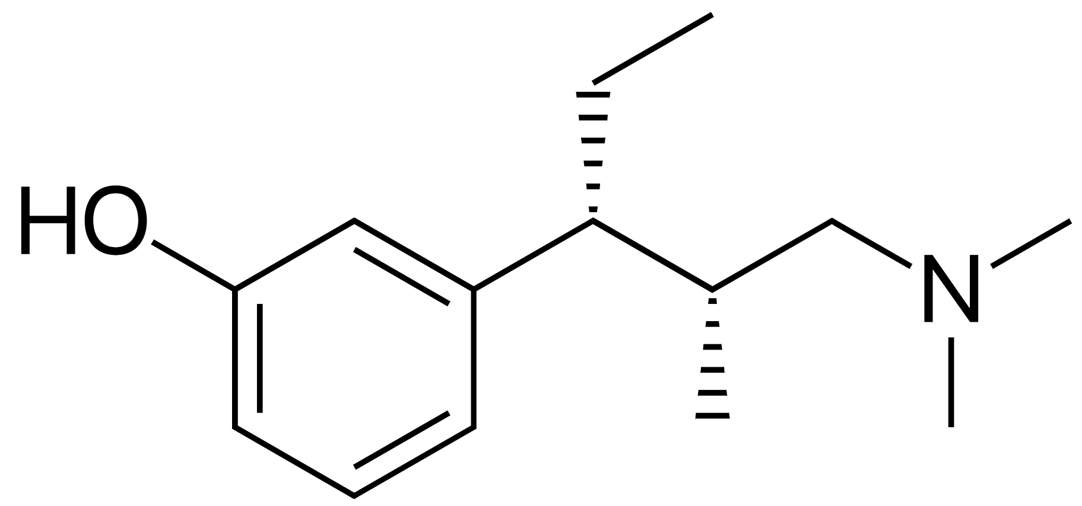
Tramadol and Tapentadol
Traits | Tramadol (Ultram) | Tapentadol (Nucynta)
Mu Receptor Affinity | Very weak (<6000x morphine) | Modest binding affinity
Serotonin | Significant serotonin reuptake inhibitor | Weak serotonin reuptake inhibitor
Norepinephrine | Little NE activity | Significant norepinephrine reuptake inhibition
Hallmark ADR | Both medications can lower seizure threshold
Trescot et al, 2008

Slide 13
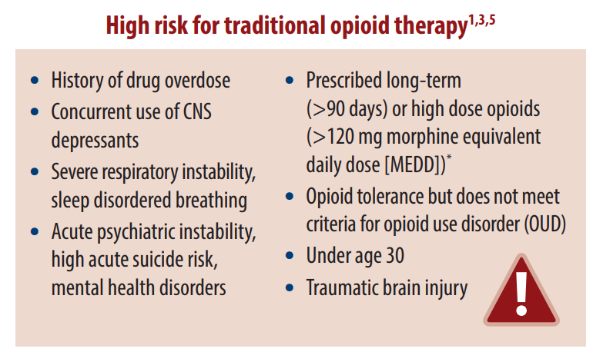
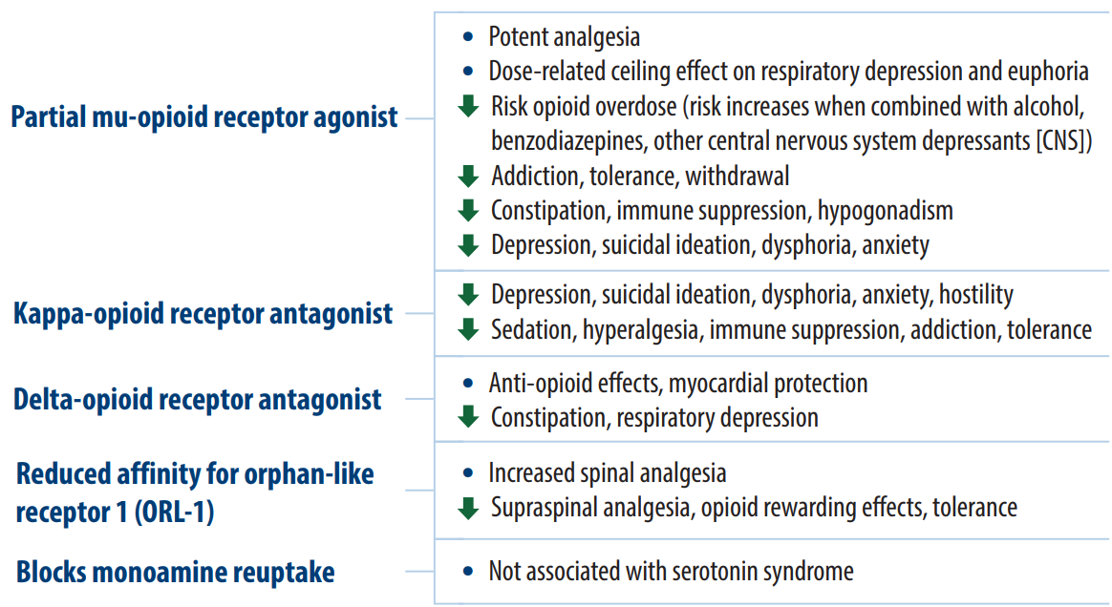
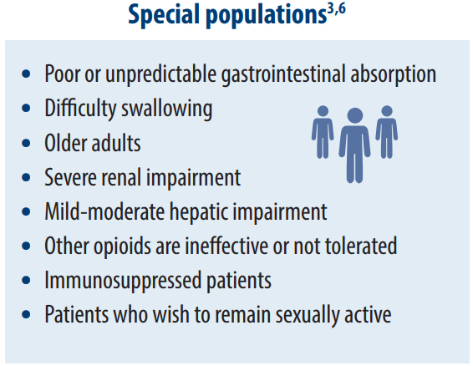
Buprenorphine for Pain
Buprenorphine for Chronic Pain 2021.

Slide 14
Common Adverse Effects
Mood Alterations – can be euphoric or dysphoric as well as anxiolytic
Sedation – Tends to improve with continuous use
Nausea/Vomiting – More prominent in morphine type opioids
Respiratory Depression – Mu opioid receptor primarily
Miosis – Reversed by naloxone
Antitussive Effect – Utilized in cough syrups as a positive
Hypothalamic Effects – Androgen deficiency
Constipation – Avoid bulk forming laxatives you want a “musher and a pusher”
Bonica’s Management of Pain, 5th Ed
Notes:
N/V due to stimuluation of CTZ

Slide 15
Other Risks
Lack of quality studies analyzing opioid vs. placebo, no opioid, or non-opioid pain reducing therapy > 1 yr
Long-Term (>90 day) use of Opioids Increases Risk of:
  Abuse/addiction: OR 14.9 (95%CI 10.4-21.5) for low dose (<36 mg morphine equivalents daily dose [MEDD])
  Fractures: Higher risk with initiation that dissipates with continued prescriptions
  Myocardial Infarction: 15-30 mg MEDD Incidence rate 1.21 (CI: 1.02 to 1.45)
  Endocrinology: Odds ratio 1.45 (CI, 1.12 to 1.87) for testosterone replacement or erectile dysfunction with long-term opioids
  Motor Vehicle Accidents: Significant increased risk with MEDD > 20 mg
Chou et al, 2015

Slide 16
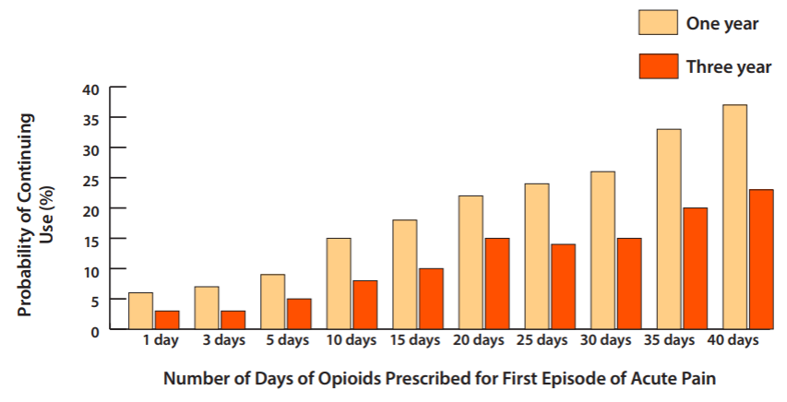
Risks Vs. Benefits
given the limited likelihood of significant long-term benefit from initiation of opioid therapy, are the benefits considered to be greater than the risks to your patient?
Graph adapted from Shah et al, 2017 by VA Academic Detailing

Slide 17
Setting appropriate expectations/functional goals
Average pain reduction 0-10 NRS is decreases from a mean of ~1 in the first 3 months of treatment to a mean of 0.5 in months 3-6
Set small goals using 90% rule – Patient is 90% sure they can complete the goal within the next 2 weeks
Areas of focus
  Exercise
  Relaxation/meditation
  Social support
  Meaningful life activities (church, family, volunteer, work)
  Pleasurable activities (hobbies and diversions)
  Attitude/mood/thinking
VA Office of Patient Centered Care and Cultural Transformation: Goal Setting in Pain Rehabilitation
Chou et al, 2020

Slide 18

Complementary health for Pain
Veterans Affairs recognizes the following as suitable for inclusion into the va’s medical benefits package
  Acupuncture
  Biofeedback
  Clinical Hypnosis
  Guided Imagery
  Massage Therapy
  Meditation
  Tai Chi/Qigong
  Yoga
VHA Directive 1137
Notes:
If I could have every patient do one thing for pain, it would be for them to see a pain psychologist

Slide 19
Designing an off ramp - tapering
This is easier to do at the initiation of opioid therapy!
Set clear, measurable goals related to both pain control and physical function
If those goals are not met, Risks > Benefits, time for dose reduction
As tolerance develops, which it will, you have to reassess if the risks of a dose increase are likely to substantially increase the quality of life and function of your patient
Notes:
Use the old, “oh, well if it isn’t working, we should look at tapering” trick

Slide 20
Audience participation question 1
Which of the following is not an appropriate expectation for pain relieving medications?
  Improved ability to play with your grandchildren
  Living pain free
  Going to church every week
  Enjoying longer walks

Slide 21
WV Legislative Requirements – Opioid Reduction Act
Patient education
  Risks of schedule 2 opioid pain medications
  Advise they can fill prescription for a lesser quantity if they wish
Quantity Limitations C2 opioids
Setting | Days Supply Limit
Emergency Room | 4 days
Urgent Care | Typically, 4 days, but may issue up to 7 days with careful documentation of medical rationale
Rx to a Minor | 3 days – Must discuss risks with guardian
Dentist/Optometrist | 3 days
Non-Dentist/Optometrist Practitioner | 7 days for initial Rx
Veterinarian | 7 days for initial Rx
WV Code Chapter 16 Article 54 - Opioid Reduction Act

Slide 22
WV Legislative Requirements – Opioid Reduction Act
Physical examination must be documented every 90 days with Schedule 2 opioids
Narcotics contract must be in place when you issue the 3rd prescription for a schedule 2 opioid -> mike would recommend with first fill of any schedule of opioid
  Only scheduled medications from this provider
  Single pharmacy
  Patient must notify prescriber of emergency resulting in prescription of a scheduled medication within 72 hours
  List members of your group if they would be able to prescribe for the patient
  Failure to adhere can result in termination of the medication or patient-provider relationship

Slide 23
WV Legislative Requirements – Opioid Reduction Act
Document the following – required for schedule 2 opioids, recommended for all opioids
  Risks of addiction and overdose
  Dangers of combining with alcohol, benzodiazepines, and other CNS depressants
  Reasons why the prescription is necessary
  Alternative treatment options
Referral to pain specialist
  Must consider at time of issuing 3rd prescription for a schedule 2 opioid and document if the patient refuses
Patient Exceptions to opioid reduction act
  Active cancer treatment, hospice care from licensed provider, residents of long-term care facilities

Slide 24
Schedule 2, 3, 4, 5 opioids
Schedule | Medication List | Refills
2 | Opium, Codeine (Depending on Strength), Hydrocodone, Hydromorphone, Morphine, Oxycodone, Oxymorphone, Fentanyl and its legal derivatives, Methadone, Tapentadol | Max 30-day supply with 1 prescription May issue up to 2 additional 30-day prescriptions with “do not fill before” wording APRNs may prescribe up to a 3 day supply of C2 opioid medications
3 | Codeine (< 1.8grams/100mL or less than 90mg per dosage unit), Buprenorphine | Max 30-day supply with 5 refills
4 | Tramadol | Max 30-day supply with 5 refills
5 | Codeine (< 0.2 grams/100mL) | Max 30-day supply with 5 refills
WV Uniform Controlled Substance Act
WV Opioid Reduction Act
Notes:
No other restrictions exist

Slide 25
Wv Nurse Practitioner opioid prescribing
APRNs may not prescribe schedule 1 controlled substances
Aprns may issue up to a 3-day supply of schedule 2 controlled substances
No other limitations on prescribing exist
WV House Bill 214 Chapter 16 Article 7 Section 15 A

Slide 26
Tele-Health Requirements Nurse Practitioners
Establish a patient-provider relationship
  In-person patient visit
  May use audio-only calls, but prefer telemedicine technology with video component
complete during call
  Identity and location of patient
  Patient’s consent for tele-health services
  Complete your appointment as you normally would and document
Comply with all federal and state laws which govern the prescribing of controlled substances
WV 19 CSR 16
Notes:
Left Ryan Haight act out b/c unsure of where it will be with the new proposed rules by the time this conference occurs. Cannot be established by texting, email, or survey

Slide 27
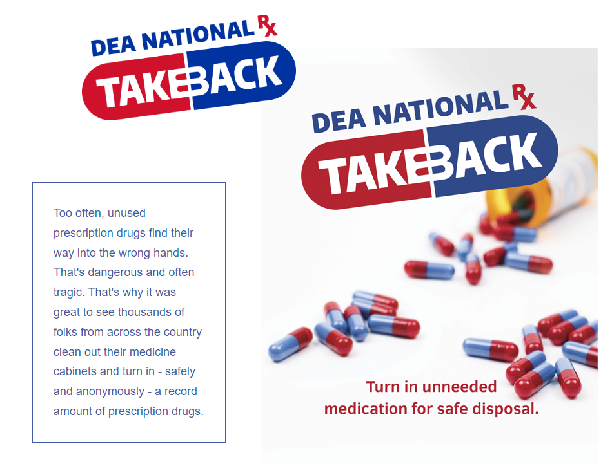
storage and Disposal of opioids
Store opioids in a locked container
Store opioids in their original packaging
Keep opioids out of reach of children
Do not share your medication
Safely dispose of unused medicine
  Preferred location at dea authorized take back site, police station, or pharmacy
  Sites can be found by searching for dea drug take back locations
Robeznieks, 2018

Slide 28
Opioid Risk Mitigation
Risk Measurement Screening Tools (COMM)
Naloxone
Urine drug testing
State database checks
Pill counts - Always perform with a witness!
Recognizing aberrant behavior

Slide 29
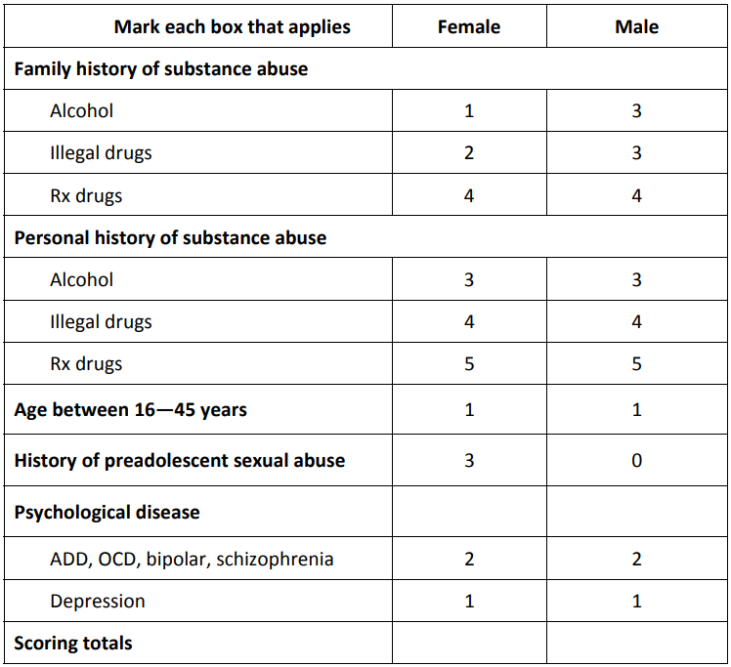
Opioid risk screening tools - Initiation
Opioid Risk Tool - ORT
Easiest to template into your progress note
Score ≤ 3 equates to low risk
Score 4-7 equates to medium risk
Score > 7 is high risk
**Even if high risk, you can still receive opioid therapy safely, but it likely requires enhanced monitoring.
Webster et al, 2005

Slide 30
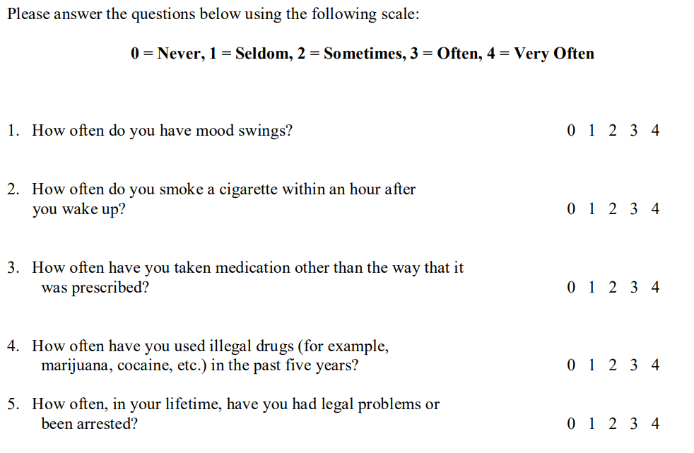
Opioid risk screening tools - Initiation
Screener and Opioid Assessment for Patients with Pain (SOAPP) – Short Form
Score of >= 4 is positive.
Sensitivity = 0.86
Specificity = 0.67
Butler et al, 2008
PainEDU SOAPP-SF

Slide 31
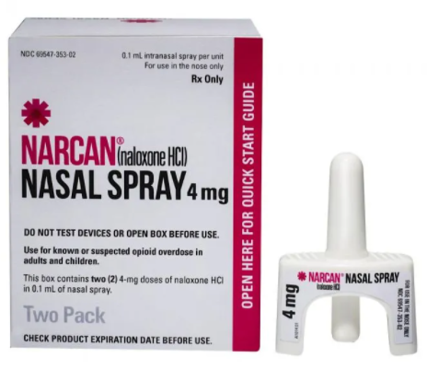
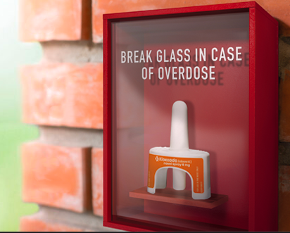
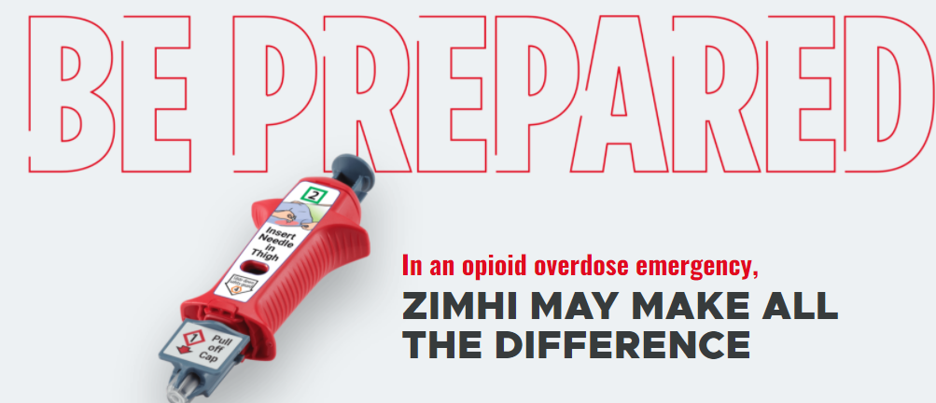
Risk Mitigation – Naloxone

Slide 32
Important Points for Patients
Tell everyone who may be in your house where you keep it
Carry it with you when out of the house
Basic Steps for Use
  Check for a response
  If no response, give naloxone and call 911
  If the patient responds, you can expect 30-90 minutes of good response
  Make sure the airway remains open
  Chest compressions
  If no response in 2-3 minutes, give a second dose of naloxone
If the patient is unconscious due to reasons other than opioid overdose, naloxone will not harm them

Slide 33

Likely Side Effects from Naloxone
Diarrhea
Fever
High blood pressure and/or tachycardia
Nausea
Runny nose
Stomach pain
Vomiting
Sweating
Lacrimation
Weakness
Seizure (Rare)

Slide 34
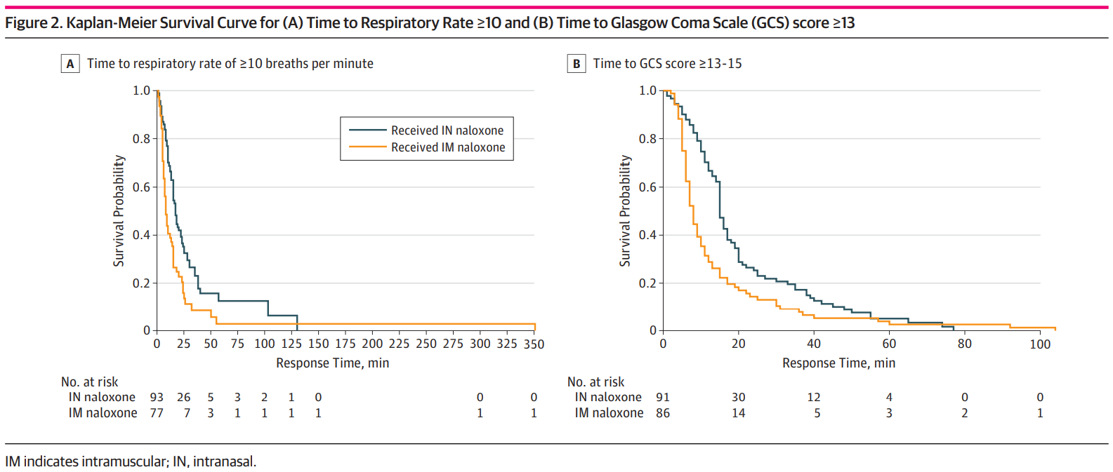
Injection vs. Intranasal Naloxone
Dietze et al 2017

Slide 35
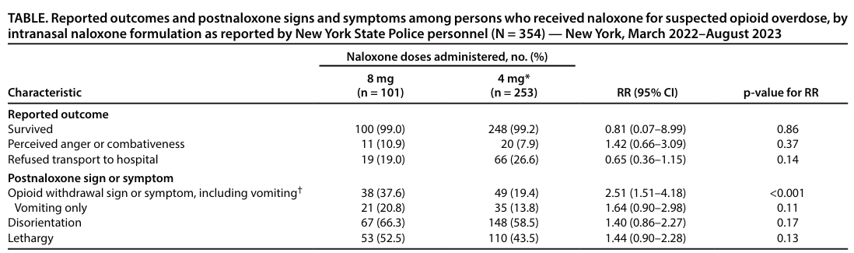
8mg vs. 4mg Nasal Naloxone
CDC MMWR 2/8/24 Vol 73 No 5

Slide 36
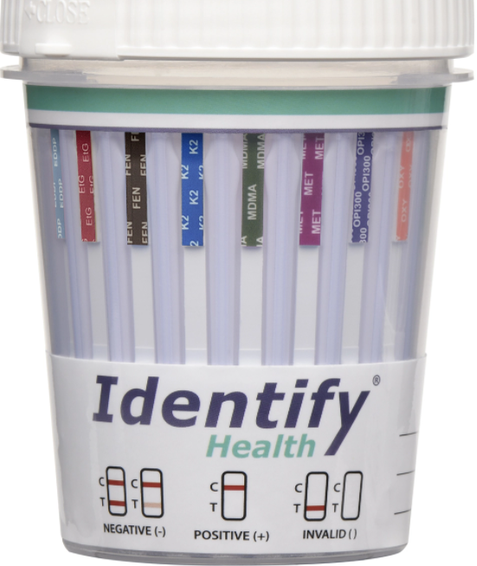
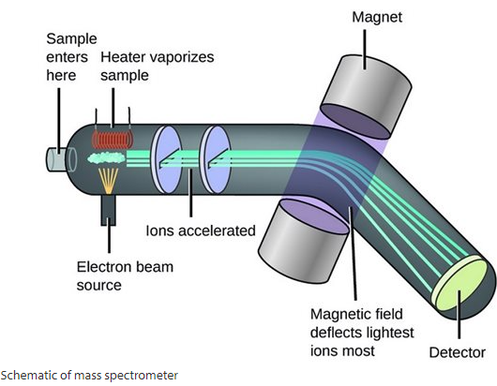
Risk Mitigation – Urine Drug Testing
Immunoassays
Drug Identification (GC/MS; HPLC/MS)
Advantages
  Rapid
  Broad – Can test for multiple substances at once
Disadvantages
  False positives possible
Advantages
  Returns specific drugs (generally quantities are not helpful)
  If it is positive, there is no disputing the result
Disadvantages
  Cost
Gourlay et al, 2015
Kale, 2019

Slide 37
Characteristics of Urine
Adulterant | Composition | Used For:
Ammonia | Ammonia | Cocaine and PCP
Bleach | Sodium hypochlorite | Broad masking
Goldenseal | Herbal diuretic | Dilutes urine Masks THC and Amp
Klear, Whizzies | Potassium nitrate | THC
Powdered urine | Dried human urine | Substitues
Stealth | Peroxide | THC and Opioids
Urinaid, Clean-X | Glutaraldehyde | Broad masking
Urine Luck | Pyridinium chlorochromate | Broad masking
Vinegar | Acetic acid | THC
Visine | Benzalkonium – Cl | THC
Water | Water | Dilutes urine
Temperature within 4 minutes of voiding = 90-100ºF
pH = 4.5 – 8.0
Urinary creatinine = >20 mg/dL (>2 mmol/L)
Specific gravity = >1.003
Gourlay et al, 2015
Kale, 2019

Slide 38
Detection Times drugs of Abuse
Drug | Blood/Plasma (Hours) | Urine (Hours) | Oral Fluid (Hours)
Amphetamine | 46 | Not Given | 20-50
Methamphetamine | 48 | 87 +/- 51 | 24
MDMA (Ecstasy) | 24 | 48 | 24
Cannabis | Varies based on use. More frequent use = longer detection window.
Cocaine (Benzoylecgonine) | 48 | 48-72 | 12-24
Heroin (Morphine as Marker) | 20 | 11-54 | 12-24
GHB | 5 | 12 | 5
Verstraete, A. Therapeutic Drug Monitoring 26(2): p 200-205, April 2004
Notes:
Can get out to 30 days or so with cannabis
Stress making sure that you include the patient in the discussion without being accusatory…you want to continue and foster health in the patient long term

Slide 39

“I took X, could it cause a false positive?”
There is no single answer to this question
You need to refer to your immunoassay technical documents for a definitive answer as different companies have different false positives
If you have GC/MS or HPLC/MS or something comparable, then it is what it says it is

Slide 40
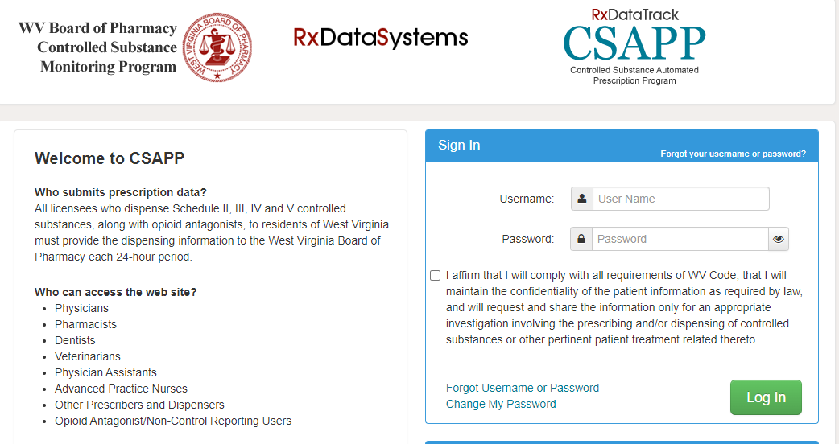
WV Controlled substance automated prescription program (csapp)
Notes:
Must be registered. Exemption for pain is terminal illness. Must run at least annually for controlled substances being prescribed for pain.

Slide 41
Recognizing Aberrant Behavior
What would concern you if you saw it in a patient with chronic pain?
Notes:
Early refill requests, not taking as prescribed, drugs from multiple prescribers or street drugs, concurrent use of sedating drugs or alcohol, intoxication, overdose, escalating pain complaints, abuse/diversion, missed or cancelled clinic visits

Slide 42
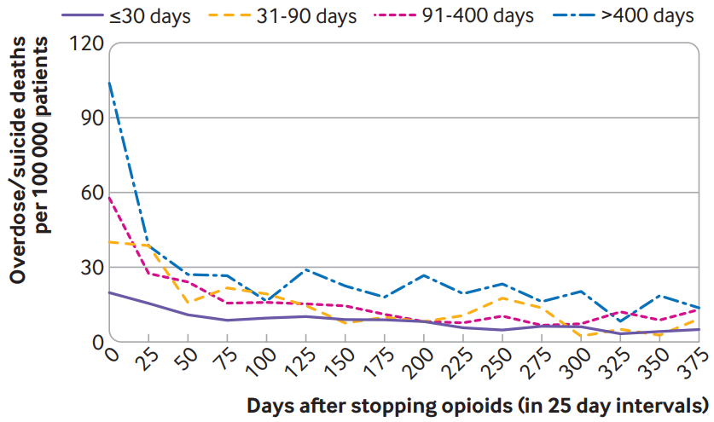
Tapering Opioid Therapy
Abrupt discontinuation or rapid taper of opioid therapy should generally be avoided unless there is an acute, significant safety risk to the patient
Involve Mental Health in the conversation
Provide support and frequent follow-up
Oliva, et al BMJ 2020; 368:m283
Notes:
They may be mad…it may not make sense, “you gave me the opioids, why are you taking them away”

Slide 43
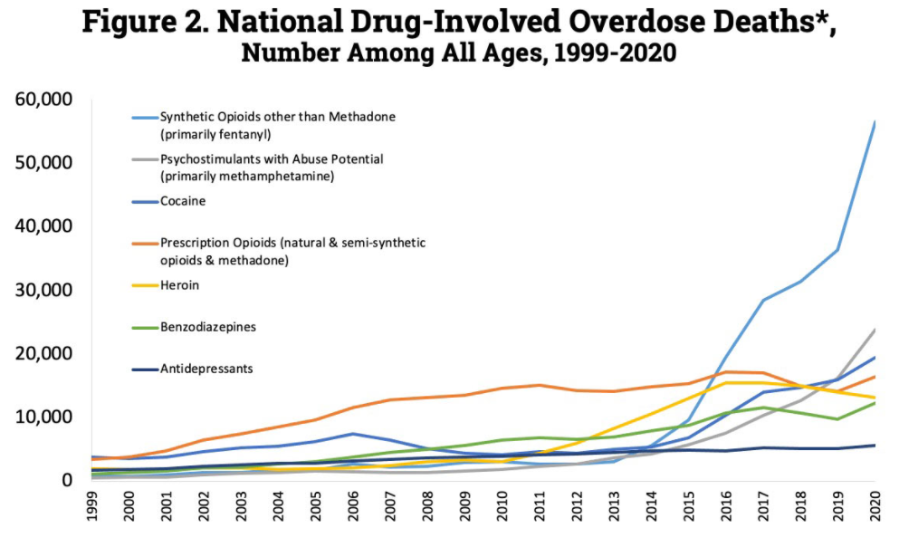
Drug Overdose Deaths (CDC)
Maps and Graphs CDC

Slide 44
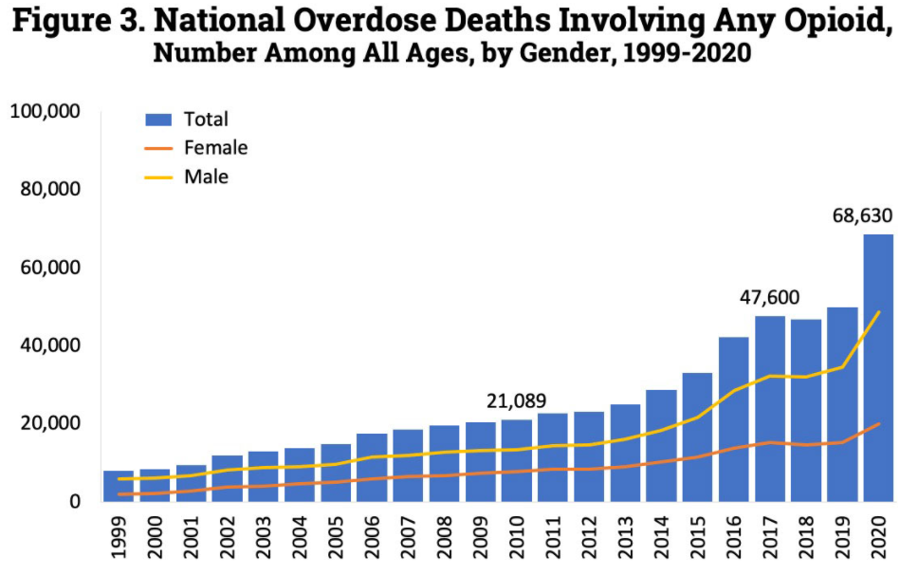
Opioid Overdose Deaths (CDC)
Maps and Graphs CDC
Notes:
Early estimates in 2021 indicate >20% increase in overdose deaths compared with prior year.

Slide 45
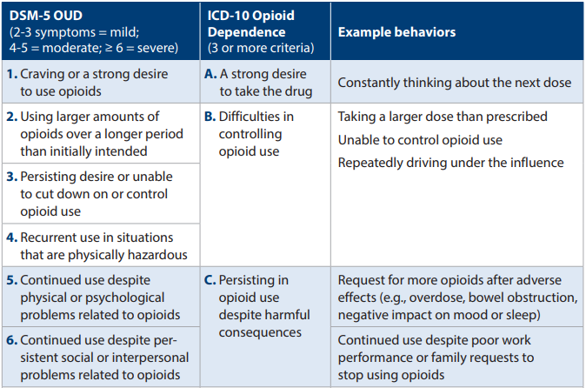
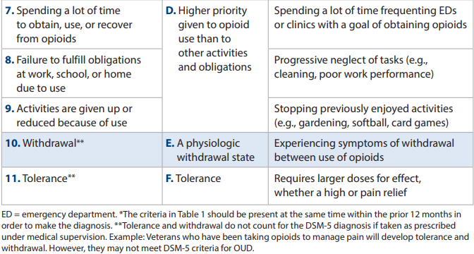
Recognizing Problems with Opioids
Opioid Deprescribing Discussion Tool 2022

Slide 46
Do Not Fear Suboxone!
Starting Insulin in T2DM
Starting Suboxone
Selecting initial dose (u/kg???)
What if you get it wrong??:
  Hyper or hypoglycemia
Monitoring treatment – HgbA1c, potentially multiple daily glucose readings, microalbumin, foot filament testing
Starts at either 2 or 4 mg
What if you get it wrong??:
  They feel crappy or stoned
Monitoring treatment – ask them how they feel and track COWs
Adapted from Ian Pace, Pharm.D. San Antonio VA

Slide 47
Audience participation question 2
Which of the following are basic risk mitigation strategies for opioid prescriptions?
  Pill counts
  State prescription drug monitoring database checks
  Urine drug testing
  Naloxone distribution
  All of the above

Slide 48
Citations
American College of Radiology (ACR): Appropriateness Criteria: https://www.acr.org/Clinical-Resources/ACR-Appropriateness-Criteria.
Ballantyne JC, Fishman SM, Rathmell JP. (2019). Bonica’s Management of Pain 5th Edition. Wolters Kluer.
Buprenorphine for Chronic Pain: Clinician Guide. (2021). https://dvagov.sharepoint.com/sites/vhaacademicdetailing/Education Materials/Forms/GroupbyCampaign.aspx?id=%2Fsites%2Fvhaacademicdetailing%2FEducation Materials%2FPain Management%2FProvider Education%2F10-1497_Provider_BuprenorphineforChronicPain_P97020%2Epdf&parent=%2Fsites%2Fvhaacademicdetailing%2FEducation Materials%2FPain Management%2FProvider Education
Butler D, Moseley G. (2017). Explain Pain Supercharged: The Clinicians Manual. Noigroup Publications.
Butler SF, Fernandez K, Benoit C, Budman SH, Jamison RN. Validation of the revised Screener and Opioid Assessment for Patients with Pain (SOAPP-R). J Pain. 2008;9(4):360-372.
Chou, R, Hartung, D, Turner, J, Blazina, I, Chan, B, Levander, X, McDonagh, M, Selph, S, Fu, Rongwei, Pappas, M. (2020). Opioid Treatments for Chronic Pain. Agency for Healthcare Research and Quality (US) 2020 Apr. Report No: 20-EHC011.
Chou R, Turner JA, Devine EB, Hansen RN, Sullivan SD, Blazina I, Dana T, Bougatsos C, Deyo RA. (2015). The effectiveness and risks of long-term opioid therapy for chronic pain: a systematic review for a National Institutes of Health Pathways to Prevention Workshop. Ann Intern Med. 162(4): 276-286.
Dietze P, Jauncey M, Salmon A, Mohebbi M, Latimer J, van Beek I, McGrath C, Kerr, D. (2019). Effect of Intranasal vs Intramuscular Naloxone on Opioid Overdose: A Randomized Clinical Trial. JAMA Netw Open. 2(11): e1914977.
Dowell D, Haegerich TM, Chou R. CDC Guideline for Prescribing Opioids for Chronic Pain – United States, 2016. MMWR Recomm Rep 2016; 65(No. RR-1): 1/49.
Dowell D, Ragan KR, Jones CM, Baldwin GT, Chou R. CDC Clinical Practice Guideline for Prescribing Opioids – United States, 2022. DRAFT.
Gourlay DL, Heit HA, Caplan YH. (2015). Urine Drug Testing in Clinical Practice. Independent Healthcare Education.
Kale N. (2019). Urine Drug Tests: Ordering and Interpreting Results. Am Fam Physician. 99(1): 33-39.
Maps & Graphs on U.S. Drug Overdose Death Rates. CDC. https://www.cdc.gov/drugoverdose/deaths/index.html .
McPherson ML. (2019). Demystifying Opioid Conversion Calculations: A Guide for Effective Dosing 2nd Edition. ASHP Publications.
Moeller KE, Lee KC, Kissack JC. (2008). Urine drug screening: practical guide for clinicians. May Clin Proc. 83(1): 66-76.

Slide 49
Citations
Oliva, E, Bowe, T, Manhapra, A, Kertesz, S, Hah, J, Henderson, P, Robinson, A, Paik, M, Sandbrink, F, Gordan, A, Trafton, J (2020). Associations between stopping prescriptions for opioids, length of opioid treatment, and overdose or suicide deaths in US Veterans: Observational evaluation. BMJ. 368: M 283.
Opioid Deprescribing Discussion Tool: A VA Clinician’s Guide. (2022). https://dvagov.sharepoint.com/sites/vhaacademicdetailing/Education Materials/Forms/GroupbyCampaign.aspx?id=%2Fsites%2Fvhaacademicdetailing%2FEducation Materials%2FPain Management%2FProvider Education%2F10-1548_PAIN_OpioidDeprescribingDiscussionTool_P97068%2Epdf&parent=%2Fsites%2Fvhaacademicdetailing%2FEducation Materials%2FPain Management%2FProvider Education
PainEDU.org (2008). SOAPP Version 1.0 – SF. https://www.mcstap.com/docs/SOAPP-5.pdf.
Robeznieks, A. (2018). 5 Tips for safely storing opioids at home. American Medical Association. https://www.ama-assn.org/delivering-care/overdose-epidemic/5-tips-safely-storing-opioids-home .
Shah A, Hayes CJ, Martin BC. Characteristics of initial prescription episodes and likelihood of long-term opioid use – United States, 2006–2015. MMWR Morb Mortal Wkly Rep. 2017;66:265–269
The Diagnosis and Treatment of Low Back Pain Work Group. (2022). VA/DoD Clinical Practice Guideline for the Diagnosis and Treatment of Low Back Pain.
Trescot AM, Datta S, Lee M, Hansen H. (2008). Opioid Pharmacology. Pain Physician. 11:S133-S153.
Valentino RJ, Volkow ND. (2018). Untangling the complexity of opioid receptor function. Neuropsychopharmacology. 43: 2514-2520.
VA Office of Patient Centered Care and Cultural Transformation. Goal Setting for Pain Rehabilitation. https://www.va.gov/WHOLEHEALTHLIBRARY/docs/Goal-Setting-for-Pain-Rehab.pdf.
Webster LR, Webster RM. Predicting aberrant behaviors in opioid-treated patients: preliminary validation of the Opioid Risk Tool. Pain Med. 2005;6(6):432-442.

