Slide 1
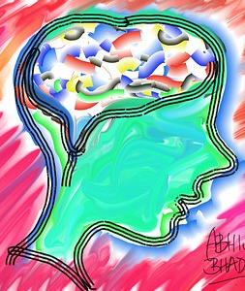
Addressing Adolescent
Mental Health Issues and High-Risk Behaviors in Primary Care
Molly Johnson, DNP, APRN, CPNP-PC
This Photo by Unknown Author is licensed under CC BY
Notes:
After infancy, adolescence is the time when our brains change the most. Today I want to talk to you about some threats to healthy brain growth and ways we as adults can help support healthy brain transformation and support mental health in teens. Throughout the talk today I want you to remember three hormones that are important to brain growth and development: melatonin, dopamine, and serotonin. We will come back to this.
The part of the brain that helps us to control impulses and make good judgment (the prefrontal cortex) doesn’t completely develop to age 25. This combined with hormonal changes can cause them to exhibit sensation-seeking, risk-taking behaviors. It also makes them more likely to crave instant gratification and social interaction.
Today I am going to talk about how social media and gaming may impact brain growth and potentially brain development. Social media and gaming can change the chemicals in the brain, affecting its reward system. Dopamine “the feel-good hormone” is a neurotransmitter and is released when the person is rewarded or when behavior is pleasurable. Smart phones give us unlimited access to dopamine and stimuli to the “feel good” pathways in our brain through “likes and rewards”. We can get the neurologic impact of dopamine without leaving the house and actual day-to-day normal life are not fun.
The pursuit of constant pleasure can lead to a lack of pleasure in anything.
However, dopamine is not for rational thinking as it does not distinguish what habits are useful and what are not. When they are released because of wrong behavior, it could create a habit that could lead to addiction.

Slide 2

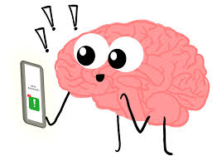
Dopamine and Reward System
Notes:
Social media apps are designed to capture the attention of their users as long and as frequently as possible. This trick is borrowed from casinos and slot machines in which they manipulate the brain chemistry, which causes social media addiction.
The act of dragging down the screen to refresh is the same as pulling the lever on a slot machine. According to psychology, these intermittent reinforcements is what hooks people in using social media. People would hope to see something exciting waiting (reward) as they continue to scroll down, but that reward is unpredictable, which keeps the person coming back for more, just as how addiction works.
Social media platforms are often designed to maximize user engagement, which has the potential to encourage excessive use and behavioral dysregulation. Push notifications, autoplay, infinite scroll, quantifying and displaying popularity (i.e., ‘likes’), and algorithms that leverage user data to serve content recommendations are some examples of these features that maximize engagement. According to one recent model, nearly a third (31%) of social media use may be attributable to self-control challenges magnified by habit formation. Further, some researchers believe that social media exposure can overstimulate the reward center in the brain and, when the stimulation becomes excessive, can trigger pathways comparable to addiction. (US Surgeon General Advisory, 2023).
CONTROL, COMPULSION, CONSEQUENCES
The problematic use of video games was incorporated as a research diagnosis (Internet gaming disorder, IGD) in the appendix of the DSM-5.
The nine DSM-5 criteria for IGD are mental preoccupation, withdrawal symptoms, the development of tolerance, a loss of control, a loss of interest in other activities, continuation despite psychosocial consequences, the deception of others, dysfunctional coping, and risks or losses (all related to or caused by video games).
These criteria must be checked for their occurrence in the previous 12 months, and at least five of the nine criteria must be met for a diagnosis of IGD.
The current International Statistical Classification of Diseases and Related Health Problems of the World Health Organization (WHO), the ICD-11, contains a category termed “Disorders due to addictive behaviors”. This includes the problematic use of video games, classified as gaming disorder (GD), and gambling, classified as gambling disorder (e.g., [6]), based on very similar criteria.
These criteria (for gaming) are (I) impaired control over gaming; (II) increasing priority given to gaming, to the extent that gaming takes precedence over other life interests and daily activities; and (III) the continuation or escalation of gaming despite the occurrence of negative consequences. Furthermore, the gaming behavior results in marked distress or a significant impairment in personal, family, social, educational, occupational, or other important areas of functioning . For gambling disorder, the formulated ICD-11 criteria are almost identical
https://nccd.cdc.gov/Youthonline/App/Results.aspx?TT=A&OUT=0&SID=HS&QID=QQ&LID=XX&YID=2021&LID2=&YID2=&COL=S&ROW1=N&ROW2=N&HT=QQ&LCT=LL&FS=S1&FR=R1&FG=G1&FA=A1&FI=I1&FP=P1&FSL=S1&FRL=R1&FGL=G1&FAL=A1&FIL=I1&FPL=P1&PV=&TST=False&C1=&C2=&QP=G&DP=1&VA=CI&CS=Y&SYID=&EYID=&SC=DEFAULT&SO=ASC
https://www.youtube.com/watch?v=P629TojpvDU
https://www.youtube.com/watch?v=0O1u5OEc5eY

Slide 3

Specific Threats from Apps
Algorithmic “Tunnel-Vision”
Location Tracking and Sharing
Ad Targeting
Exposure to bullying, sexual behaviors, and aggression
Notes:
Algorithms on YouTube, TikTok, Spotify, Snapchat, and more risk putting kids into a spiral of videos and podcasts that negatively impacts their mental well-being. They are also vectors for depressive thoughts.
YouTube’s video suggestions have been shown to subtly guide users to hateful or highly inappropriate sexual material.
many other ad-supported apps risks falling into a harmful cycle that further exposes them to unrealistic body expectations or risky products like vape pens.
Even apps like Words with Friends, ESPN, and Kaspersky security apps fall into this category because they consume unusually high amounts of user data they re-sell to third-party ad networks that appear across the web. These ad networks work like this:
A young girl interested in makeup, fashion, or glamour likely watches related YouTube videos, reels, or feeds.
Sensing the girl consumes these feeds and videos, ads begin appearing, offering new channels, feeds, videos, and products.
These ads can be so well-targeted they’re impossible to ignore, even if they’re never tapped on.
Ads, by extension of the algorithm that presented them, can encourage viewers to believe in or pursue unachievable body standards and unrealistic expectations of beauty and self-worth.
Teens may inadvertently expose where they live or frequently bike, run, or skateboard when posted to fitness tracking apps.
Apps like Strava, All Trails, Map My Ride, Nike Run Club, and others are great ways to share activity with friends and family. They can encourage healthy competition and offer accountability for completing daily or weekly fitness goals.
But they also show maps of runs, rides, walks, and other outdoor distance activities. This can inadvertently expose patterns — like every Tuesday after school, they go for a runon a nearby trail — or where you live by showing consistent start and finish points.
While most dating apps have systems in place to spot users under 18 to protect their own interests, they’re not immediate, and 16 or 17-year-old kids frequently lie about their age and may be able to pass as 18. Know that just because they don’t have an app installed on their phone doesn’t mean they’re not using websites directly, too.
The biggest risk is a young teenager who gets tricked or purposefully falls for someone much older than them.

Slide 4
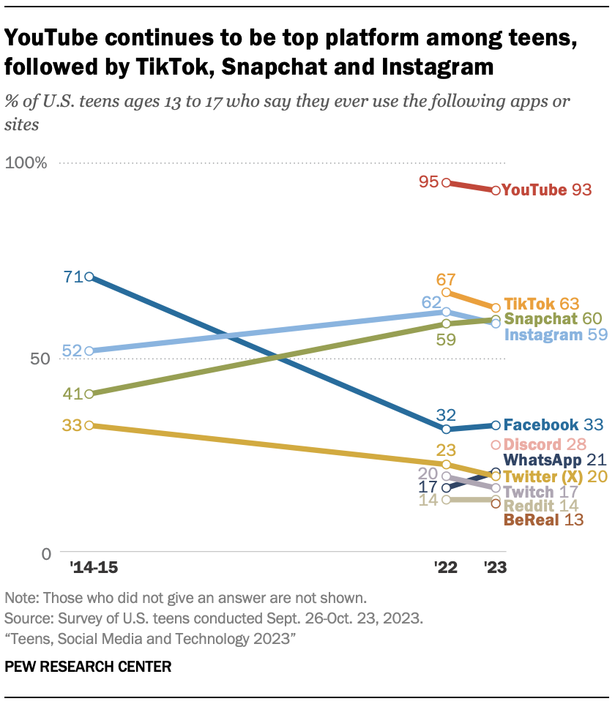
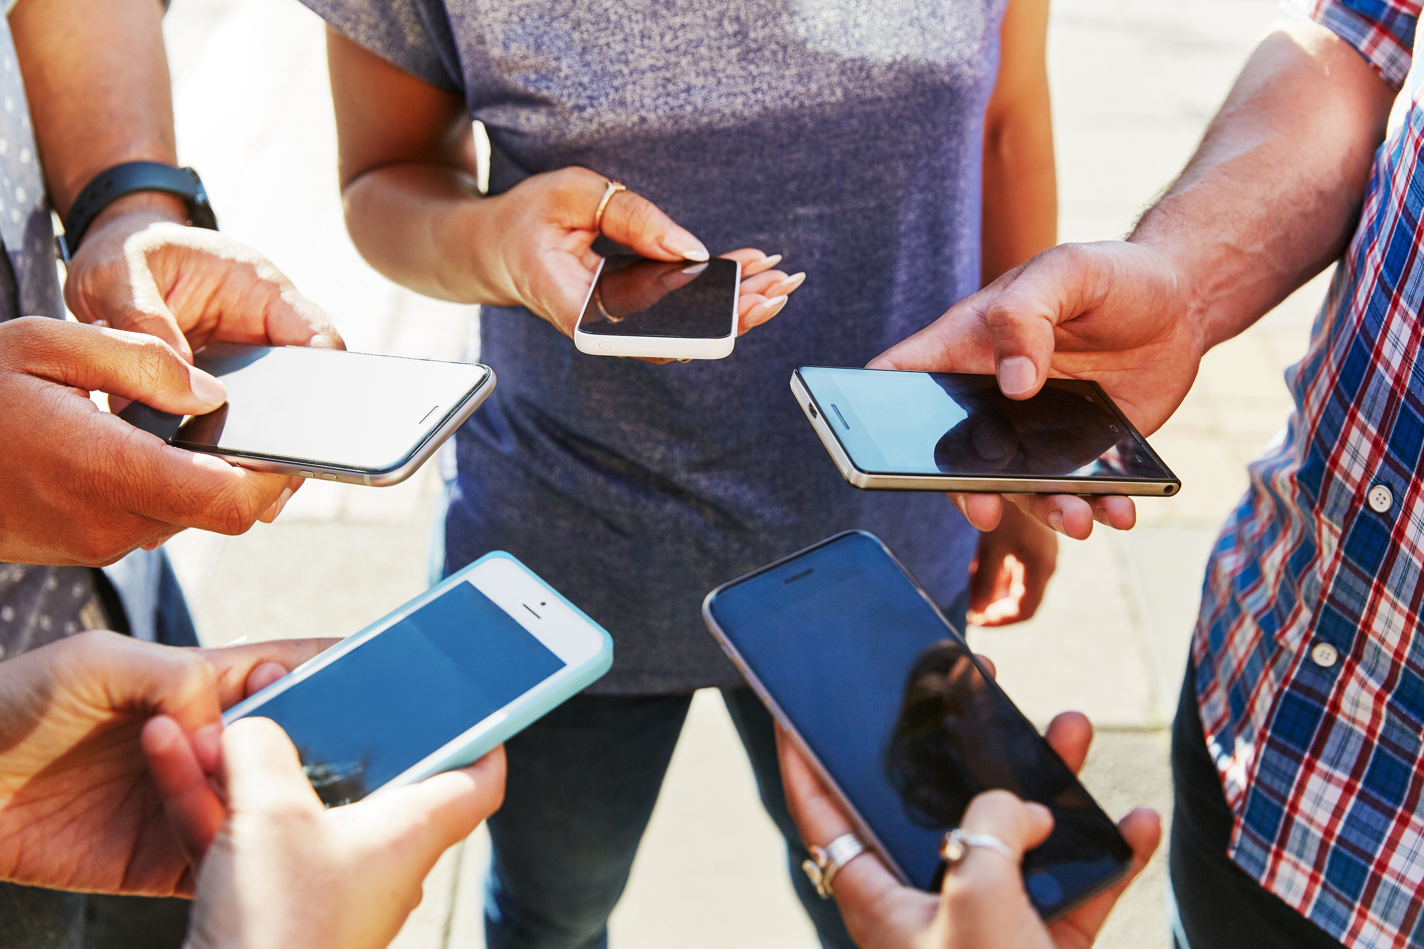
Teen Use of Social Media Platforms
Notes:
95% of teens have access to a smartphone, 90% use desktop/laptop computer
9 out of 10 say they used YouTube
Majorities of teens ages 13 to 17 say they use TikTok (63%), Snapchat (60%) and Instagram (59%). For older teens ages 15 to 17, these shares are about seven-in-ten.
https://www.pewresearch.org/internet/2023/12/11/teens-social-media-and-technology-2023/
According to a 2013 UN study, more people on earth have access to cell phones than toilets.
Out of the world’s estimated 7 billion people, 6 billion have access to mobile phones. Far fewer — only 4.5 billion people — have access to working toilets. Of the 2.5 billion who don’t have proper sanitation, 1.1 billion defecate in the open, according to the study.

Slide 5
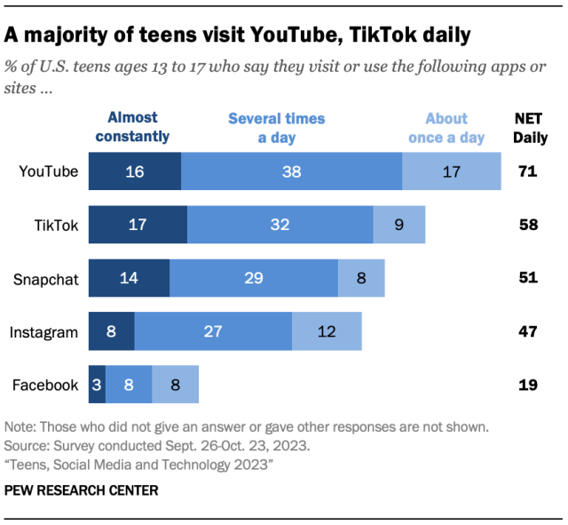
Teen Frequency of Interaction on Online Platforms
The average American spends 2 hours and 7 minutes on social media every day.
About 58% of teens are daily users of TikTok
~50% use Snapchat and Instagram daily.
Girls more likely to use TikTok, SnapChat, Instagram. Boys more likely to use Discord, Twitch, Reddit, YouTube.
Notes:
Nearly half of teens say they use the internet “almost constantly.
https://www.pewresearch.org/internet/2023/12/11/teens-social-media-and-technology-2023/

Slide 6
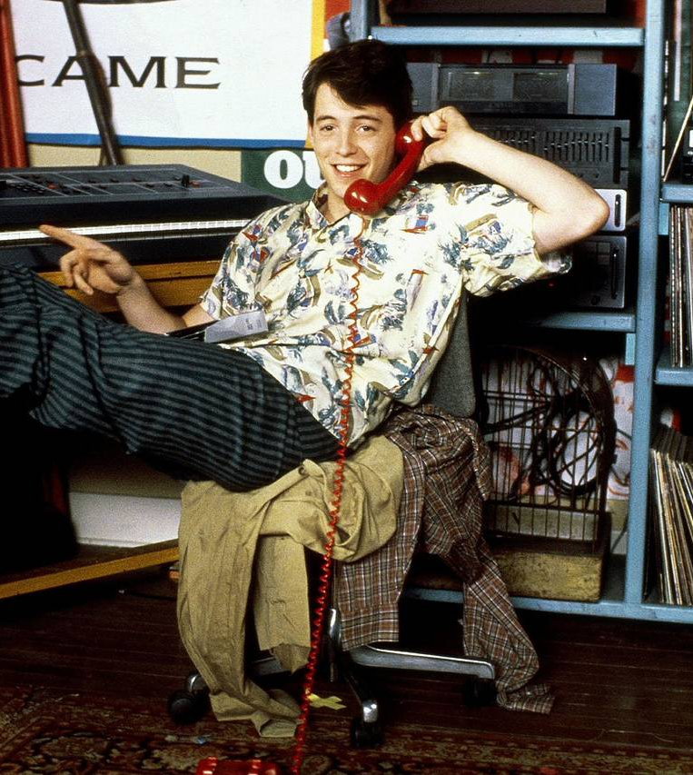
Positive Effects of Social Media
Social Connection & Support
Identity Formation
Learn New Information
Display Creativity
Notes:
For youth who have anxiety or struggle in social situations, practicing conversations over social media can be an important step toward feeling more comfortable interacting with peers in person. Social media can also help kids stay in touch with their support networks. That can be especially important for kids from marginalized groups, such as LGBTQ+ adolescents who may be reluctant or unable to discuss their identity with caregivers (Craig, S. L., et al., Social Media + Society, Vol. 7, No. 1, 2021). In such cases, online support can be a lifeline.
80% said social media gives them some level of connection to what is going on in their friends’ lives, 71% said it’s a place where they can show their creativity, 67% said social media reassures them that they have people to support them through tough times, and 58% said it makes them feel more accepted, according to the survey.
https://www.cnn.com/2022/11/16/health/teens-social-media-pew-survey-wellness/index.html

Slide 7

Body Dissatisfaction
Disordered Eating
Sleep Cycle Disturbance
Depression
Anxiety
Cyberbullying
Sexual Exploitation
Financial Exploitation
Fear of Missing Out (FOMO)
Negative Effects
of Social Media
Notes:
https://www.forbes.com/advisor/business/social-media-statistics/
https://www.pewresearch.org/internet/2022/12/15/teens-and-cyberbullying-2022/pi_2022-12-13_teens-cyberbullying_0-01/
Nearly half of U.S. teens ages 13 to 17 (46%) report ever experiencing at least one of six cyberbullying behaviors (offensive name calling, spreading of false rumors, receiving explicit images they didn’t ask for, constantly being asked where they are, physical threats, having explicit images of them shared without their permission. conducted April 14-May 4, 2022.
Females most likely to experience bullying. Black teens more likely than white or Hispanic teens to say online harassment and bullying are a problem for people their age.
67% of adolescents feel worse about their lives as a result of social media use
29.3% reported that their mental health was most of the time or always not good
42.3% felt sad or hopeless (almost every day for 2 or more weeks in a row so that they stopped doing some usual activities, during the 12 months before the survey)

Slide 8


Recognize the impact of your age on your interaction with adolescents ☺

Slide 9
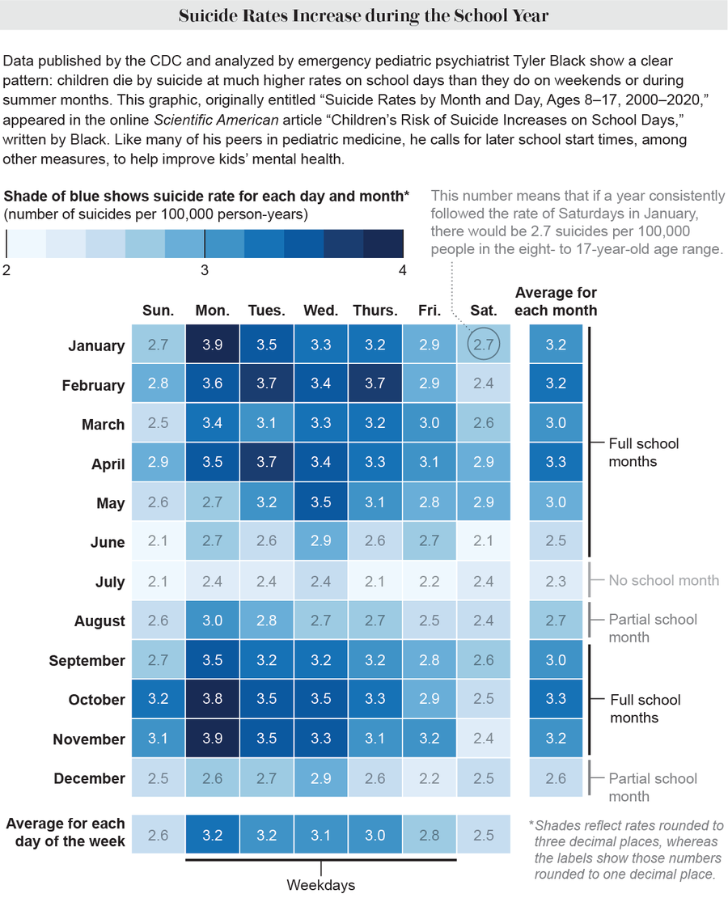
Adolescent Suicide Statistics
22% seriously considered attempting suicide (during the 12 months before the survey)
10.2% actually attempted suicide
(one or more times during the 12 months before the survey)
CDC-2023
United States, High School Youth Risk Behavior Survey, 2021
Notes:
Females- twice as likely as males to have actually attempted suicide
Approximately one third (30.0%) of female students in 2021 reported that they had seriously considered attempting suicide during the 12 months before the survey.
2021, 9th- and 10th- grade female students were significantly more likely than 12th-grade students to seriously consider attempting suicide, make a suicide plan and report a suicide attempt
Gaylor EM, Krause KH, Welder LE, et al. Suicidal Thoughts and Behaviors Among High School Students — Youth Risk Behavior Survey, United States, 2021. MMWR Suppl 2023;72(Suppl-1):45–54. DOI: http://dx.doi.org/10.15585/mmwr.su7201a6.

Slide 10
Platform | Specific Dangers
YouTube | Potential exposure to inappropriate content, data collection on users, algorithm can direct children to inappropriate content, fake information, targeted ads
Snapchat | Disappearing messages, users may share explicit or inappropriate content- challenging for parents to monitor
Instagram | Exposure to inappropriate content and focus on appearance that may impact self-esteem- Direct messaging feature
TikTok | Inappropriate material and potential privacy concerns, may encounter content that is not suitable for their age group
Discord | Bullying, exposure to explicit content (NSFW), malware and phishing scams
Twitch | Interaction with adult strangers, live streaming- no way to take back information or regulate content to viewers, financial exploitation through “tips” to their favorite streamers

Slide 11
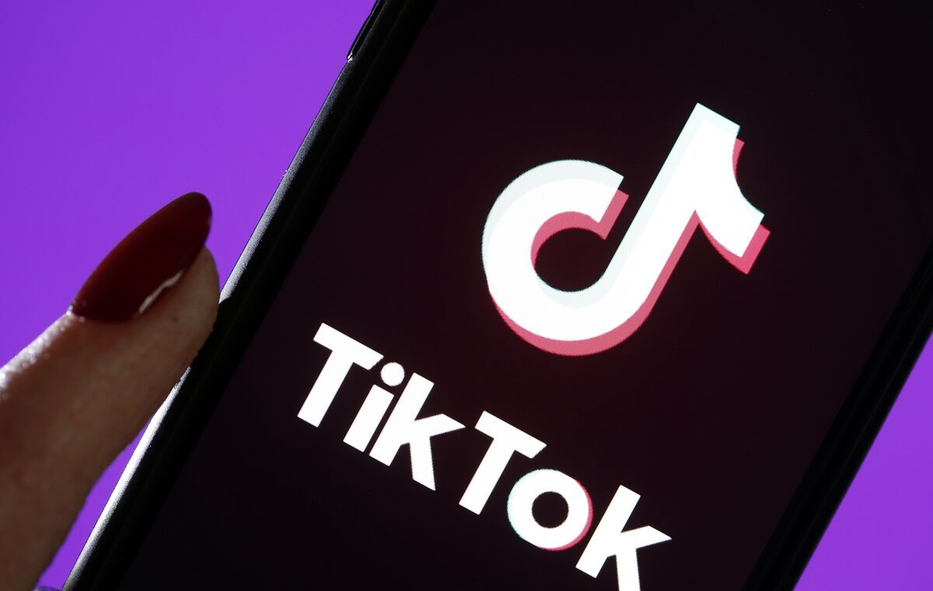
TikTok
This Photo by Unknown Author is licensed under CC BY-SA-NC
Notes:
Parents need to know that TikTok is a social network for sharing user-generated videos, many of which feature music and sound effects. The app involves a lot of songs, and you can expect swearing and sexual content in some. Though videos viewed during the review process contained only some tight/revealing clothing, depending on which accounts users follow and what content they like, it's possible to encounter sexually suggestive and explicit material. In 2019, in response to an FTC settlement, the app launched TikTok for Younger Users for users under 13, allowing them to view curated videos but not comment, search, or post their own videos (and their data isn't collected). But because full access to TikTok only requires users to enter a birth date, the app is still recommended for older teens. As of 2022, TikTok features a Family Pairing mode that lets parents link their account to their kids' and set daily time limits, place kids' accounts on Restricted mode, which limits their exposure to content that may not be appropriate, and disable direct messages
TikTok review by teen on https://www.commonsensemedia.org/app-reviews/tiktok
“TikTok is not a good app for younger people. Firstly, there is videos that contain sexual references, people in revealing clothing, and iffy stuff like boyfriends and girlfriends kissing. Second, a lot of the dares and stunts in the videos are actually dangerous and kids can see those people as role models. Third, a lot of the things you can see in TikTok are fake, misleading, or contain violence. The swearing is also a big problem, with people saying anything they want because there’s no rule that says you can’t swear.”
“Everyone is overreacting- you might get some weird stuff whenever you first download it but once the algorithm learns what you like then all the weird horny stuff goes away, if you find that kinda stuff on your kids FYP then they've been liking similar videos- there will be language- not really any violence”

Slide 12

Discord
This Photo by Unknown Author is licensed under CC BY
Notes:
Discord:
Parents need to know that Discord is a voice- and text-chat tool with a significant gamer presence. Its developers created it to replace other voice-over-internet protocol (VOIP) apps that gamers use to talk to each other in real time while they play games, especially MMOs (massively multiplayer online games). People with other interests now use the app, too. Users can log in with a username, and they can add friends, join a server, and chat by logging in with a code provided from an email invitation or from a real-life friend. People can send direct messages to each other, chat, and talk or listen in larger group chats. Using a feature that scans for people you know when adding friends (with location features turned on) lets you find users who are near you. In recent years, Discord has made some moves to reduce the amount of adult content -- including settings that allow all direct messages kids receive to automatically be scanned and deleted if they contain explicit content, and friend requests that can be limited to people they share a server with and presumably would know. Users who are under 18 also can't view NSFW communities -- although if kids enter an older age when registering, that won't apply.
Ratings from kids on https://www.commonsensemedia.org/app-reviews/discord/user-reviews/adult
“so i'll be honest , as a person that is under 15, i'll give my honest review on how my experience on using discord for less then a year was like. its time consuming, exhausting and gets draining after a bit, you have your fun for a bit and then just spend all day in your room doing nothing, that is unless you're able to balance your in real life and online life, which was something i failed to for around a month or two, before i later ended what was left of my online life (pheww) dont let your kids get it, i mean i get it, it's your choice and it just depends on how they use the app in general, but it's not really worth it and if you do let them, give them a few months on the app and they'll get bored. BUT, depending on what side of discord you're on, they'll be bound to run into pedos, racists and genuinely people that aren't at their best, resulting in manipulation, guilt tripping, grooming and more
“This is pretty much just a chatting app. Here is kind of a summary if you don’t know too much about it. Discord is a chatting app for computer, IOS and android. It is pretty much a buffed up apple messenger. You can use a lot of “cool” features like custom emojis, stickers, voice call, etc. However it isn't only for your friends. You can join different servers, and im assuming your kid will want to join their favorite online creator if they have a server. It is pretty much a giant group chat, where fans can chat, post memes, and stuff like that. Even though it is advertised for gaming, a majority of it isnt gaming. I would say 50/50 gaming and other. Usually memes or funny videos. But, as you would expect from an app with teens chatting, people do curse. But, if you join big creators servers, most times you cant curse or you will get banned. So bad words is probably the worst. Also v dont seem to be checked, but i havnt seen anything too bad. Nothing worse than some bad words. I would say anyone 11+ can handle this, but use common sense and dont talk to random strangers.”

Slide 13

Twitch
This Photo by Unknown Author is licensed under CC BY-NC
Notes:
Twitch streamers provided their names (47%) and stated their location 50% of the time. 38% provided detailed schedules of when they would be live, and 64% linked and encouraged viewers to follow their other public social media. Viewers were able to donate money to 37% of streamers
https://www.netnanny.com/blog/the-hidden-dangers-of-twitch/
https://www.commonsensemedia.org/website-reviews/twitch/user-reviews/child
Parents need to know that Twitch is an online streaming site that covers both gaming and non-gaming content. It has many settings that can help restrict kids' contact with other users, such as options that block private chat-room invites. The site also makes a concerted effort to keep sexual content from being shared, putting temporary or permanent bans on users who break these rules. But even with these standards, kids may encounter iffy stuff. Language is often a free-for-all during live feeds, with "f--k" and other swear words frequently used, even though channel streamers are supposed to indicate whether they'll use mature language during a stream. Many users and streamers make drug and alcohol references during broadcasts, too. Plus, a number of games feature a significant amount of shooting and violence,
Kid Reviews:
“Don’t go on twitch much, but I find it perfectly fine just as YouTube. Say there are some bad stuff that are on it like “ Hot tub streaming” where almost naked women/men go on and stream themselves.”
“...Swearing, drinking/drugs, sex, etc. but again, THIS COMPLETELY DEPENDS ON THE CHANNEL! Even then, a lot of these channels provide warnings before hand. Hot tub streams can easily be blocked and there is a very clear report button. Overall, you can easily use this site without fault despite all the negatives.”

Slide 14
Platform | Specific Dangers
Whisper | Users can share secrets anonymously, which can lead to cyberbullying, inappropriate conversations, or even predatory behavior
Yubo | “Tinder for Teens”, users can create profiles without age verification, can livestream and engage in conversations with people in their area
Hoop | HOOP connects with Snapchat, shows you Snap profiles of other users, and allows you connect with them or swipe away to the next Snap profile. Once they’ve exchanged Snap info inside of Hoop, the rest of the conversation happens in Snapchat.
Monkey | Monkey is a social networking app that allows users to video chat with other users randomly chosen by the app, no age verification (min. age 13), high risk for sexual content (removed from Apple app store but available on Web)

Slide 15

Yubo
This Photo by Unknown Author is licensed under CC BY-SA
Notes:
https://www.commonsensemedia.org/app-reviews/yubo
Yubo lets users create a profile, share their location, and flip through images of other users in their area. You can either scroll through the current livestreams or browse individual profiles by swiping Tinder-style -- right on profiles you like and left on profiles you don't. Terms state that users must be over 13, but it's easy to fudge the date. Upon registration, the app presents users with a teen safety guide; it also sends the information to users via text message and reminds users frequently about posting appropriate content. Still, during the time of review, it was easy to find substance use, profanity, racial slurs, and scantily clad people.
“I was on the app and met this good looking guy and we were talking and so we added each other’s snap chat and he was sending me pics of him shirtless and one thing leaded to another and he was black mailing me with my “nudes” and threatens to post them on the web, SO NO DONT ADD THIS APP THERE ARE TOO MANY PEOPLE THAT WILL TAKE ADVANTAGE OF YOUNG GIRLS AND THINK ITS OKAY AND I DONT WANT THIS TO HAPPEN TO YOU!! “
“Yubo is 'friends' app. I think that this app could defiantly be a good thing however in my experience it's being used as a dating app or sexting. Many people ask for nudes, and if you give them your Snap-chat you better be ready to receive pictures you didn't ask for. I've found a friend on there that is lovely but more often than not it's just been ' send me nudes or where do you live wanna chat '

Slide 16

Monkey
Notes:
https://www.commonsensemedia.org/app-reviews/monkey
Parents need to know that Monkey randomly connects teens with other Snapchat users for a 10-second video chat. They can add more time or add the person on Snapchat to continue the connection. Before connecting, teens will see the age and gender of the potential friend, and they can accept the video chat or not. The terms of service allow users ages 13 and older, but there's no verification of age.
“Nearly all my friends have it and i hate it they try to message them and then the boys start asking for nudes and then they hate them all of a sudden and its stupid anyway why cant you just go out and about and meet people?”

Slide 17
Resources for Adolescent Primary Care
Screen
Intervene
Refer
Notes:
CONTROL, COMPULSION, CONSEQUENCES
Indicators of problematic social media use include a) a tendency to use social media even when adolescents want to stop, or realize it is interfering with necessary tasks; b) spending excessive effort to ensure continuous access to social media; c) strong cravings to use social media, or disruptions in other activities from missing social media use too much; d) repeatedly spending more time on social media than intended; e) lying or deceptive behavior to retain access to social media use; f) loss or disruption of significant relationships or educational opportunities because of media use.

Slide 18
Screen: If we don’t ask, they won’t tell
Problem | Screening Tool
Social Media/ Gaming Addiction | Problematic and Risky Internet Use Screening Scale (PRIUSS) Internet Gaming Disorder Scale-Short Form; Video Game Addiction Questionnaire; Social Media Disorder Test and Social Media Disorder Test for Parents; Bergen Social Media Addiction Scale, Internet Addiction Test; Social Media Use Questionnaire; Problematic and Risky Internet Use Screening Scale (18-items) ; Gaming and Social Media Questionnaire; Social Media Addiction Questionnaire
Depression | PHQ-2 and PHQ-9
Anxiety | GAD-7
Sleep Cycle Disturbance | Single Item Sleep Quality Questionnaire; Pittsburgh Sleep Quality Index; Childhood and Adolescent Sleep Evaluation Questionnaire (CASEQ
Substance Abuse/Vaping/ Electronic Cigarettes | CRAFT 2.1+N

Slide 19

Avoiding & Combatting Social Media Addiction
Cognitive Behavioral approaches
Family Media Plan (technology boundaries at home)
Find Balance- “Breaks are not Punitive”
Open Communication
Digital Citizenship and Digital Literacy Education
Notes:
Taking time off- A small, randomized controlled trial in college-aged youth found that limiting social media use to 30 minutes daily over three weeks led to significant improvements in depression severity. This effect was particularly large for those with high baseline levels of depression who saw an improvement in depression scores by more than 35%. Another randomized controlled trial among young adults and adults found that deactivation of a social media platform for four weeks improved subjective well-being (i.e., self-reported happiness, life satisfaction, depression, and anxiety) by about 25–40% of the effect of psychological interventions like self-help therapy, group training, and individual therapy.
Findings reveal that adolescents with higher daily TSSM had a 59.6% increase in terms of the risk of depression when compared with the reference group. Furthermore, the risk of depression increased by 13% for each hour increase in social media use, and these associations were stronger for adolescent girls than boys; however, boys still demonstrated a significant increase in depression risk.
Liu M, Kamper-DeMarco KE, Zhang J, Xiao J, Dong D, Xue P. Time Spent on Social Media and Risk of Depression in Adolescents: A Dose-Response Meta-Analysis. Int J Environ Res Public Health. 2022 Apr 24;19(9):5164. doi: 10.3390/ijerph19095164. PMID: 35564559; PMCID: PMC9103874.
Setting limits and boundaries combined with coaching from adults is the best way to promote positive outcomes-Wachs, S., et al., Computers & Education, Vol. 160, No. 1, 2021)
Health Literacy: https://health.gov/healthliteracyonline/

Slide 20
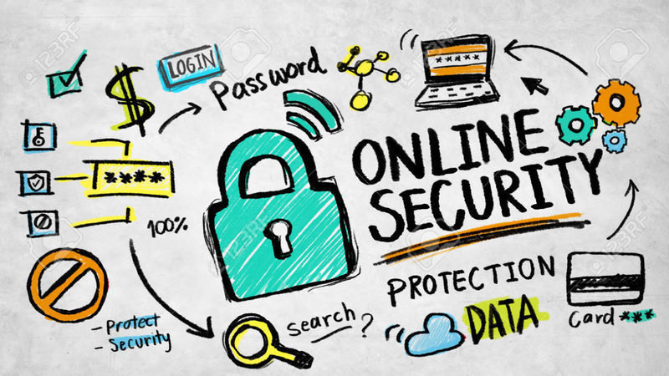
Safeguarding Children in Online Environments
Parental Controls
Safe Search
Strict Privacy Settings
Cover Webcams
Notes:
1. Parental control is a set of features and tools designed to help parents manage and supervise their children’s internet activities via wireless internet. These controls are typically integrated into Wi-Fi routers, operating systems, or dedicated software applications. ‘The primary goal of parental control is to protect children from inappropriate or harmful content, control their screen time, and prevent potential online dangers such as cyberbullying, phishing, and exposure to explicit material.
2. SafeSearch helps you manage explicit content in your search results, like sexual activity and graphic violence

Slide 21

Parental Control Apps
Notes:
AI program: Scans texts, emails, and Apps for concerning behavior. Allow you to block sites, set time limits, switch to turn off devices. Does not allow you to see all of the content- only the most concerning. It will send alerts with screen . Location check-ins.
Bark Plans range from $5-14/month. Premium Plans

Slide 22

Common Sense Media https://www.commonsense.org/

Slide 23
How to Report Abusive Behavior on Commonly Used Platforms
Facebook | https://www.facebook.com/help/181495968648557
Twitter | https://help.twitter.com/en/safety-and-security/report-abusive-behavior
Instagram | https://help.instagram.com/165828726894770/
Twitch | https://safety.twitch.tv/s/article/Filing-a-Report?language=en_US
YouTube | https://www.youtube.com/howyoutubeworks/policies/community-guidelines/
TikTok | https://www.tiktok.com/safety/en/reporting/
SnapChat | https://help.snapchat.com/hc/en-us/articles/7012399221652-How-do-I-report-abuse-or-illegal-content-on-Snapchat
WhatsApp | https://faq.whatsapp.com/1313491802751163/?locale=en_US
Discord | https://discord.com/safety/360044103651-reporting-abusive-behavior-to-discord

Slide 24
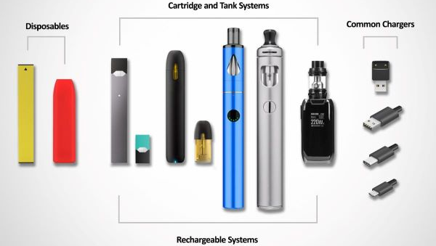
Electronic Nicotine
Delivery Devices
Notes:
E-cigarettes produce an aerosol by heating a liquid that usually contains nicotine, flavorings, and other chemicals that help to make the aerosol.
The liquid used in e-cigarettes often contains nicotine and flavorings. This liquid is sometimes called “e-juice,” “e-liquid,” “vape juice,” or “vape liquid.”
Users inhale e-cigarette aerosol into their lungs. Bystanders can also breathe in this aerosol when the user exhales it into the air.
E-cigarette devices can be used to deliver marijuana and other drugs.
JUUL is a brand of e-cigarette that is shaped like a USB flash drive. Like other e-cigarettes, JUUL is a battery-powered device that heats a nicotine-containing liquid to produce an aerosol that is inhaled.
All JUUL e-cigarettes have a high level of nicotine. According to the manufacturer, a single JUUL pod contains as much nicotine as a pack of 20 regular cigarettes.

Slide 25
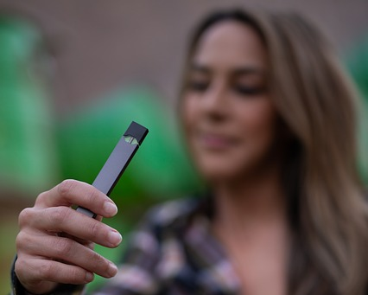

Vaping and E-Cigarette Use
This Photo by Unknown Author is licensed under CC BY-NC-ND
This Photo by Unknown Author is licensed under CC BY-SA-NC
Notes:
18% Currently used electronic vapor products
(including e-cigarettes, vapes, vape pens, e-cigars, e-hookahs, hookah pens, and mods, such as JUUL, SMOK, Suorin, Vuse, and blu, on at least 1 day during the 30 days before the survey)
7.3% Currently used electronic vapor products frequently
(including e-cigarettes, vapes, vape pens, e-cigars, e-hookahs, hookah pens, and mods, such as JUUL, SMOK, Suorin, Vuse, and blu, on 20 or more days during the 30 days before the survey)
5.0 Currently used electronic vapor products daily
(including e-cigarettes, vapes, vape pens, e-cigars, e-hookahs, hookah pens, and mods, such as JUUL, SMOK, Suorin, Vuse, and blu, on all 30 days during the 30 days before the survey)
In contrast- only 3.8% of respondents are currently smoking
High School YRBS 2021 (https://nccd.cdc.gov/Youthonline/App/Results.aspx?TT=C&SID=HS&QID=H48&LID=XX&LID2=SL&YID=2021&YID2=SY&SYID=&EYID=&HT=C03&LCT=LL&COL=S&ROW1=N&ROW2=N&TST=false&C1=&C2=&SC=DEFAULT&SO=ASC&VA=CI&CS=Y&DP=1&QP=G&FG=G1&FA=A1&FR=R1&FS=S1&FSC=P1&FSI=I1)

Slide 26


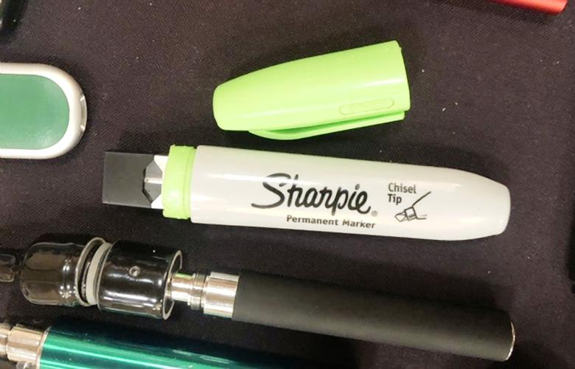
Education to Recognize Vaping Devices
Notes:
https://www.cdc.gov/tobacco/basic_information/e-cigarettes/Quick-Facts-on-the-Risks-of-E-cigarettes-for-Kids-Teens-and-Young-Adults.html
Although most parents (96.2%) had seen or heard of e-cigarettes, only 55.9% had seen or heard of JUUL, and only 44.2% accurately identified an image of JUUL as a vaping device.

Slide 27
Cycle of Nicotine Dependence
Use of Electronic Inhalation Devices
Depression
Anxiety
The most common reason youth give for continuing to use e-cigarettes is “I am feeling anxious, stressed, or depressed.”
Teens may turn to vaping to try to deal with stress or anxiety. But that use can become a cycle of nicotine dependence.
https://www.cdc.gov/tobacco/basic_information/e-cigarettes/Quick-Facts-on-the-Risks-of-E-cigarettes-for-Kids-Teens-and-Young-Adults.html
Notes:
A study of more than 2,500 people ages 13-24 found that nicotine-only vapers, THC-only vapers and dual vapers (of nicotine and THC) were more likely to report anxiety symptoms, depressive symptoms and suicidal thoughts when compared with their peers who did not use electronic cigarettes or vape THC.
https://newsroom.heart.org/news/depression-anxiety-symptoms-linked-to-vaping-nicotine-and-thc-in-teens-and-young-adults#:~:text=Approximately%2060%25%20of%20the%20nicotine,reported%20among%20THC%2Donly%20vapers.
The analysis of the participants’ survey responses found:
Approximately 70% of the THC-only vapers and 60% of the nicotine-only vapers and dual vapers reported experiencing anxiety symptoms — such as worries, flashbacks, panic attacks and situational anxieties— within the past week, compared to about 40% of participants who had never vaped.
Over half of the nicotine-only vapers, THC-only vapers and dual vapers reported experiencing symptoms of depression — such as difficulty engaging in or being interested in activities normally enjoyed, whether they felt that depression interfered with their ability to do the things they needed to do at work, at school or at home and whether depression interfered with their social life and relationships — within the past week, compared to 25% of non-vapers.
More than 50% of people in all vaping groups reported having suicidal thoughts within the past 12 months, compared to only one-third of the non-users.
About a quarter of the dual vapers and nicotine-only vapers started vaping nicotine to calm down or feel less stressed, and one-third of participants in both groups reported that they currently vaped nicotine to cope with feelings of anxiety. In contrast, about half of THC-only vapers started vaping THC and currently vaped THC to relieve anxiety symptoms.
Around 20% of nicotine-only vapers and dual vapers started vaping to help feel less depressed and currently vaped for this reason. About one-third of THC-only vapers started vaping THC and nearly half currently vaped TCH to feel less depressed

Slide 28
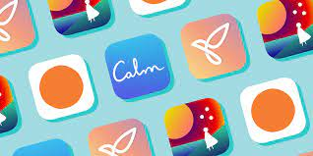
Mental Health Apps for Teens

Slide 29

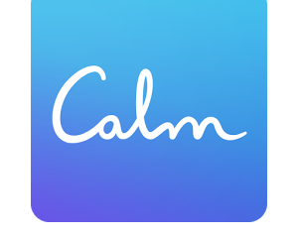

Mental Health Apps for Teens
Headspace
Calm
One Sec
Notes:
Headspace
This is one of the more recognized mindfulness apps available. It focuses on teaching meditation and mindfulness skills from world-class experts. There are hundreds of guided meditations focusing on everything from sleep to anxiety and mind-body health.
Calm
This is a popular app for sleep, meditation, relaxation, and sleep stories. Soothing bedtime stories, some narrated by celebrities, help users relax and fall asleep naturally.
One sec app asks you to 'take a breath' before checking social media.

Slide 30

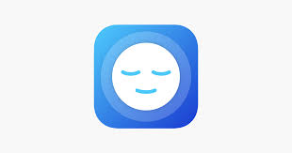


Mental Health Apps for Teens
Mindshift CBT
Calm Harm
Breathwrk
Insight
Notes:
Calm Harm ($1.99)
This app provides tasks to the client to help them in resisting the urge to self-harm. The client can also add their own tasks and coping skills into the app. Activity types vary from comfort, distraction, release, and expressing yourself. The client can track their triggers, trends, and progress to help “ride the wave.”
Insight
This app has received many awards as a meditation aid. It offers guided meditations and talks by top mindfulness experts, neuroscientists, psychologists, and teachers to help calm the mind, reduce anxiety, manage stress, sleep deeply and improve happiness.
Mindshift CBT
This app uses scientifically proven strategies based on Cognitive Behavioral Therapy (CBT) to “help you learn to relax and be mindful, develop more effective ways of thinking, and use active steps to take charge of your anxiety.” Focuses on challenging negativity and developing effective ways of thinking.
Breathwrk: This app aims to teach you hundreds of breathing techniques to help you sleep, learn meditation and mindfulness, improve your athletic performance, and even reduce your addiction cravings.

Slide 31
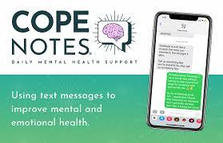

Mental Health Resources for Teens
Notes:
Mental Health is Health: MTV Entertainment Group’s online resource designed to start conversations, encourage help-seeking, and share tools to help us take care of ourselves and the people we know and love. The site gives us access to tips, tools, and support — including articles and videos — by helping us explore how we’re feeling (lonely, sad, angry), what we’re experiencing (break-ups, discrimination), or conditions (depression, eating disorders) we need to manage.
Cope Notes: Subscribers sign up to receive daily text messages from Cope Notes. Cope Notes interrupts negative thought patterns by injecting positivity at random points throughout the day. Subscribers are encouraged to read, internalize, and interpret these messages based on their current feelings and situation in life. They are also encouraged to interact with the messages by writing back their feelings and thoughts - allowing them to speak freely without judgment.

Slide 32
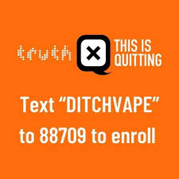

Resources for Teen Tobacco Addiction
Text “Start My Quit” 36072
Notes:
MyLifeMyQuit : The My Life, My Quit specially trained coaches listen and understand teens, provide personalized support, and build relationships that promote quitting tobacco.
This is Quitting by the Truth Initiative: This is Quitting is a free and anonymous text messaging program from Truth Initiative designed to help young people quit vaping. The first-of-its-kind quit program incorporates messages from other young people like them who have attempted to, or successfully quit, e-cigarettes.

Slide 33

Promote Sleep
Insufficient sleep is associated with disruptions to neurological development in adolescent brains, teens’ emotional functioning, and risk for suicide (APA, 2023)
On a typical weekday, nearly 1 in 3 adolescents report using screen media until midnight or later
The CDC estimates that 72.7% of high school students sleep less than 8 hours per night during weekdays.
Notes:
https://www.cdc.gov/healthyschools/features/students-sleep.htm
Sleep disorders can drive/worsen emotional dysregulation, which in turn may contribute to the onset and/or maintenance of sleep disturbances. Moreover, sleep disorders may increase the risk of psychological problems and psychiatric disorders, which in turn may induce and/or maintain sleep disturbances (APA, 2023).
As their sleep time decreases, their use of tobacco and drugs increases, including drugs that could help them stay awake. They tell us that getting one less hour of sleep a day leaves them feeling hopeless and, sometimes, suicidal. Research has shown that suicide risk in children increases during the school year, and sleep deprivation could be a contributing factor.
Researchers have told us that sleepy teens are more prone to car crashes and that even 30 minutes of extra sleep would help alleviate some mental health concerns.
https://www.scientificamerican.com/article/let-teenagers-sleep/

Slide 34
Professional Resources
Resource | Location
Cincinnati Children’s Hospital Provider Resources | https://healthvine.cincinnatichildrens.org/provider-tools-resources/#1660931884187-eb9867aa-0800
American Academy of Pediatrics Center of Excellence on Social Media and Youth Mental Health | https://www.aap.org/en/patient-care/media-and-children/center-of-excellence-on-social-media-and-youth-mental-health/
American Psychological Association Health Advisory on Social Media Use in Adolescence | https://www.apa.org/topics/social-media-internet/health-advisory-adolescent-social-media-use
Brigham & Women’s Hospital Sleep Health Institute and Healthy Hours | Sleep 101: http://sleep101.info/
Stanford Medicine Tobacco Prevention Toolkit | https://med.stanford.edu/tobaccopreventiontoolkit.html
National Institute of Mental Health | https://www.nimh.nih.gov/health/topics/child-and-adolescent-mental-health

Slide 35
Thank you
Molly Johnson, DNP, APRN, CPNP-PC
johnsom4@ohio.edu

